Slide 1
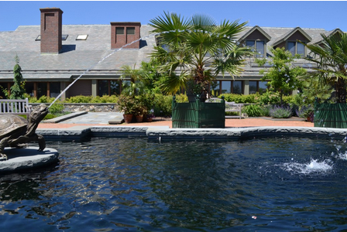
Georgia Department of Education
Image borrowed from: http://www.yummymath.com/2013/my-teacher-says-this-stream-is-parabolic-is-he-correct/
Algebra Content in High School Mathematics

Slide 2
Who is here today?
Introduce yourself, tell us your name, school, grade level and your expectations for the day

Slide 3
Clarification on A.REI.12
Before Standard Revision
A.REI.12 Graph the solutions to a linear inequality in two variables as a half-plane (excluding the boundary in the case of a strict inequality), and graph the solution set to a system of linear inequalities in two variables as the intersection of the corresponding half-planes.
After Standard Revision
A.REI.12 Graph the solution set to a linear inequality in two variables.

Slide 4
Clarification on A.CED.3
Represent constraints by equations or inequalities, and by systems of equations and/or inequalities, and interpret data points as possible (i.e. a solution) or not possible (i.e. a non-solution) under the established constraints.
Students will:
Create, solve, and model graphically linear equations and inequalities in one and two variables
Create, solve, and model graphically systems of linear equations in two variables
Create and interpret systems of linear inequalities

Slide 5
Clarification on A.REI.12 and A.CED.3
Graphing systems of linear inequalities will still be addressed in the Coordinate Algebra and Algebra I frameworks but WILL NOT be assessed on the Milestones.
This topic can be taught as an extension.

Slide 6
http://www.youcubed.org/the-good-bad-of-mathematics-education/

Slide 7
What stood out to you about the article?
Where do you spend most of your time?
What happens when these are out of balance?
What would it look like if these were balanced?

Slide 8
Standards for Mathematical Practice
1. Make sense of problems and persevere in solving them.
2. Reason abstractly and quantitatively.
3. Construct viable arguments and critique the reasoning of others.
4. Model with mathematics.
5. Use appropriate tools strategically.
6. Attend to precision.
7. Look for and make use of structure.
8. Look for and express regularity in repeated
reasoning.

Slide 9
Visualizing Square Roots
MGSE9-12.N.RN.2 Rewrite expressions involving radicals and rational exponents using the properties of exponents. (i.e., simplify and/or use the operations of addition, subtraction, and multiplication, with radicals within expressions limited to square roots).

Slide 10
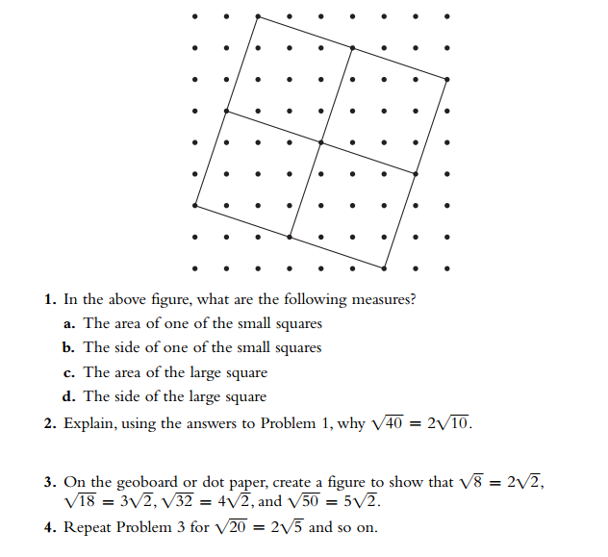
Visualizing Square Roots

Slide 11
Naming the Algebra Tiles
x²
x
1
-x²
-x
-1

Slide 12
Algebra Tiles On-Line Power Point
http://mathbits.com/MathBits/AlgebraTiles/AlgebraTiles/AlgebraTiles.html

Slide 13
Algebra Tiles: A Sampling of Prior Knowledge
Use algebra tiles to simplify each expression.
Use algebra tiles to solve each equation for x.
Notes:
This serves to remind teachers about skills in which middle school students may have used algebra tiles. Also, high school teachers are likely new to the idea of a “zero pair” or “zero sum” so these problems will prepare them for factoring trinomials.

Slide 14
Multiplying Binomials Using Algebra Tiles
A.APR.1 Add, subtract, and multiply polynomials; understand that polynomials form a system analogous to the integers in that they are closed under these operations.

Slide 15
Factoring Trinomials Using Algebra Tiles
A.SSE.3a Factor any quadratic expression to reveal the zeros of the function defined by the expression.

Slide 16
Completing the Square Using Algebra Tiles
A.SSE.3b Complete the square in a quadratic expression to reveal the maximum and minimum value of the function defined by the expression.

Slide 17
Solving Equations by Completing the Square
How might the process of completing the square with Algebra tiles help students better understand how to solve quadratic equations by completing the square?
Notes:
If time allows, let teachers try to solve the two equations by completing the square.

Slide 18
Lunch

Slide 19
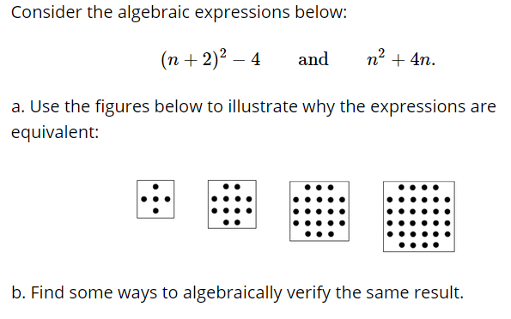
Seeing Dots
Notes:
https://www.illustrativemathematics.org/content-standards/tasks/21

Slide 20
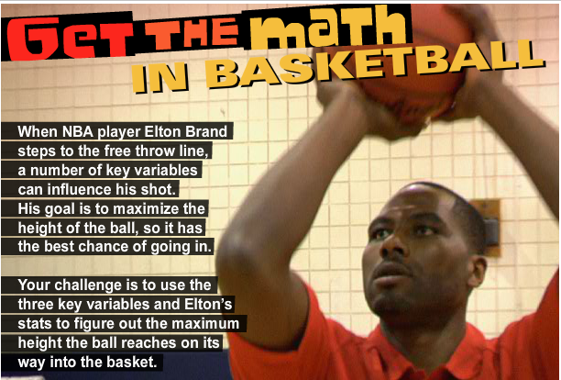
Math in Basketball
http://www.thirteen.org/get-the-math/teachers/math-in-basketball-lesson-plan/activities/206/

Slide 22
Math in Basketball
A.SSE.3a – Factor expressions to reveal zeros
A.CED. 1 – Create quadratic equations
A.CED. 2 – Create quadratic equations in two variables; graph equations
A.REI.4 – Solve quadratic equations
http://www.thirteen.org/get-the-math/teachers/math-in-basketball-lesson-plan/activities/206/

Slide 23
Math in Basketball
This task is loosely reminiscent of a 3-Act Task
Act 1 – Present the information (What do you wonder?)
Act 2 – What do you need to know to solve this problem?
Act 3 – Reveal the solution
Google: Dan Meyer 3-Act

Slide 24
GoFAR Question

Slide 25
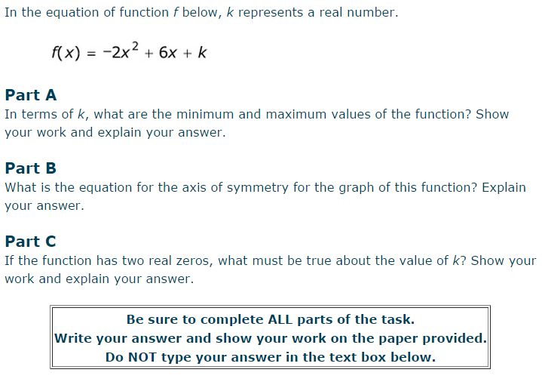
GOFAR Question

Slide 26
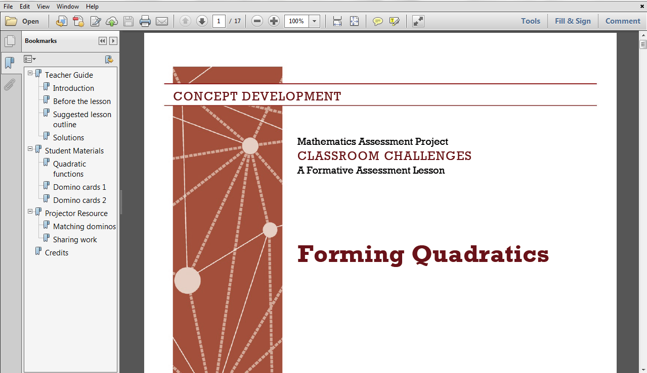
Forming Quadratics
http://map.mathshell.org/

Slide 27
Forming Quadratics: Pre-Assessment

Slide 28
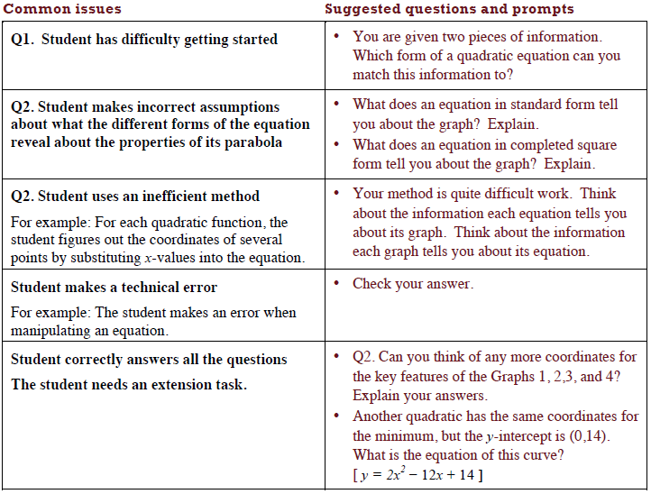
Assessing Student’s Responses

Slide 29
Matching Dominos
Take turns at matching pairs of dominos that you think belong together.
Each time you do this, explain your thinking clearly and carefully to your partner.
It is important that you both understand the matches. If you don't agree or understand, ask your partner to explain their reasoning. You are both responsible for each other’s learning.
On some cards an equation or part of an equation is missing. Do not worry about this, as you can carry out this task without this information.

Slide 30
Sharing Work
One student from each group is to visit another group's poster.
If you are staying at your desk, be ready to explain the reasons for your group's matches.
If you are visiting another group:
Write your card matches on a piece of paper.
Go to another group's desk and check to see which matches are different from your own.
If there are differences, ask for an explanation. If you still don't agree, explain your own thinking.
When you return to your own desk, you need to consider as a pair whether to make any changes to your own work.

Slide 31
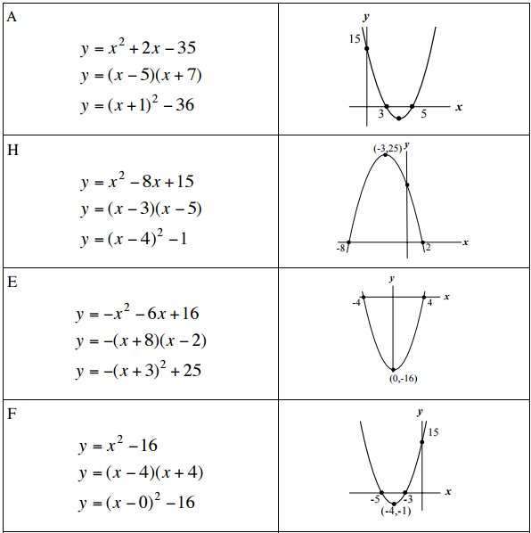
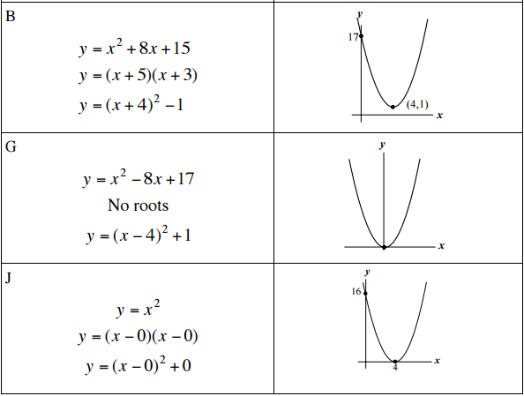
Forming Quadratics Solutions
http://map.mathshell.org/

Slide 32
U.S. Population
Do you think Mike’s model was appropriate for predicting the population in 1990?
Do you think Mike’s model was appropriate for predicting the population in 2015?
How do you think your students will answer these questions?
http://www.census.gov/popclock/
Notes:
For students, I would ask them to turn to their partner and discuss these two questions
Hand participants a copy of U.S. population data from 1800-2010.

Slide 33
U.S. Population: An Extended Look
Is there a model that will more accurately predict U.S. population?
Work with your group to find a model and test it for 2015.

Slide 34
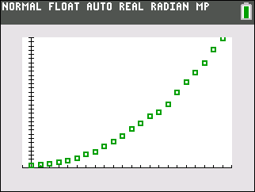
U.S. Population

Slide 35
Content Standards
Summarize, represent, and interpret data on two categorical and quantitative variables
S.ID.6 Represent data on two quantitative variables on a scatter plot, and describe how the variables are related.
S.ID.6a Decide which type of function is most appropriate by observing graphed data, charted data, or by analysis of context to generate a viable (rough) function of best fit. Use this function to solve problems in context. Emphasize linear, quadratic and exponential models.

Slide 36
Reflection
What value does the graphing calculator bring to this task?
What Standard(s) for Mathematical Practice were used in this task?

Slide 37
Comprehensive Course Overview
www.georgiastandards.org

