Slide 1
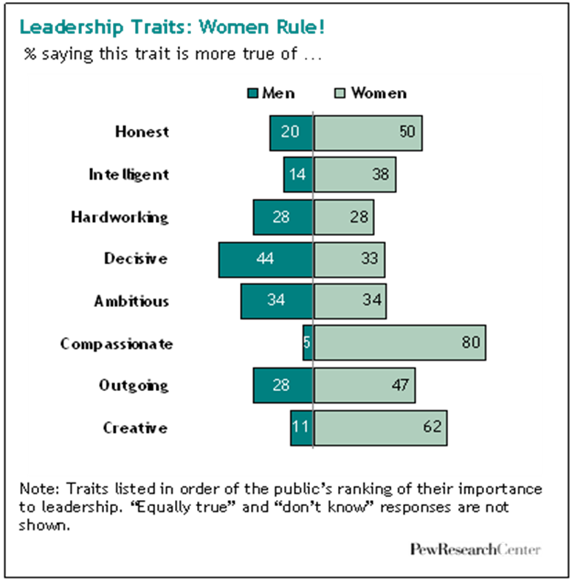
Opening April 29, 2015
Does the data presented support or refute your opinions about male versus female leadership? Explain. Use evidence from our previous lessons to support your response.
Notes:
http://www.bing.com/videos/search?q=what+makes+a+great+leader+kids&qs=n&form=QBVR&pq=what+makes+a+great+leader+kids&sc=1-30&sp=-1&sk=#view=detail&mid=00808C1870987A62728C00808C1870987A62728C

Slide 2
Purpose: To engage in a collaborative discussion that develops and challenges our current opinions and thoughts.
Activator: Let’s KAHOOT & Discuss!

Slide 3
Closing: Collaborative Sharing
Collaborative Sharing Accountable Talk Prompts:
-The evidence I’ve collected is relevant because…
-The resources or evidence that have influenced my thinking most are…
-I feel strongly that…
-I am still interested in…

Slide 4
Opening: Reading Mini Lesson
Text: Blog Post (Male Versus Female Leadership)
During Reading: Annotate points that support or refute your opinion.
After Reading: This text will become an additional piece of evidence to support you during the writing work session.

Slide 5
Opening: Reading Mini Lesson
Text: Blog Post (Male Versus Female Leadership)
Blog Post #1 Leave a comment on this blog post Mar 31, 2014 12:13 PM In my 34+ years in the industry, I've seen male and female team and company leadership. I've seen good and bad on both sides. It all comes down to personality traits, charisma, and trust. If you trust your leadership and if they demonstrate vision, competence and fairness, it is easy to follow them. If not, not. Overall, I've seen a tiny advantage to the male side over the female side, but I suspect that's merely an artifact of society's past bias in favor of male leaders and the greater number of male leaders, rather than any real quality of leadership or gender. Leadership, like all such endeavors, is a human-powered activity. In the end, if you have the native talent and skills to be a great leader, you can be - male or female. Reply

Slide 6
Opening: Reading Mini Lesson
Text: Blog Post (Male Versus Female Leadership)

Slide 7
Focus Standards
Trace and evaluate the argument and specific claims in a text, assessing whether the evidence is relevant and sufficient to support the claims.

Slide 8
Work Session: Writers Are Picky! (Select at least 2 writing tasks.)
***State Your Claim! Write an argumentative constructed response that presents your thoughts about female versus male leadership. Use evidence you’ve collected to support your argument. Claim Supporting Evidence Implications of the Real World | Story Teller: Using evidence you’ve collected, write a short narrative that reveals the importance of male or female leadership. You narrative should include: Characters Dialogue Descriptive Details | You’re The Boss: Suppose you are hiring a new employee to manage your Health & Wellness Center. Would you seek out male or female leadership? Write an explanatory response using evidence you’ve collected to explain your reasoning for selecting a male or female.
Chart It: Reflect upon male and female teacher that has taught you or currently teachers you. Create a T-chart that outlines each of their leadership qualities. Then compare and contrast these two leaders and how their leadership qualities make them a successful educator. (Use pseudonyms.) | Challenge Envelope! Complete one of the writing task on the grid. Before you begin, you must research and find two additional ideas that support or refute your opinion of female versus male leadership. (Use your own device or a Nook.) | Talk It Through: Check in at the small group conferencing table to receive support from your classmates or Ms. Morris.

Slide 9
Work Session: Writers Are Picky!
What resources will support you during the work session?

Slide 10
State Your Claim: Example
Leadership is important in all areas of our lives. Female leadership is the way to go! Female leaders possess leadership traits that allow them to lead effectively. A significant amount of evidence proves that female leaders are more equipped than males. For example, female leaders are compassionate, organized, and great listeners. They understand the importance of caring about the people they led and actively listening. They also understand how being organized can help a group of people soar! Although men are confident and hardworking, female leaders bring more to the table. Without a doubt, I support female leadership.

Slide 11
State Your Claim: Example
Male leadership rocks! They are confident, decisive, and ambitious. A male leader knows when to speak up and take control. For example, think about a male lead scientist who has been charged with leading a team. This male would easily begin planning for the group and confidently see the plan through. He would also motivate the group to work hard and stick to the plan. Although women can be caring and great organizer, a male is needed to any job done. Male leadership makes the ultimate difference.

Slide 12
Work Session: Check In!

