Slide 1
A Retelling of The Story of Andromeda
A Greek Myth to Explain What We See in the Night Sky
Georgia Department of Education
May 2018

Slide 2
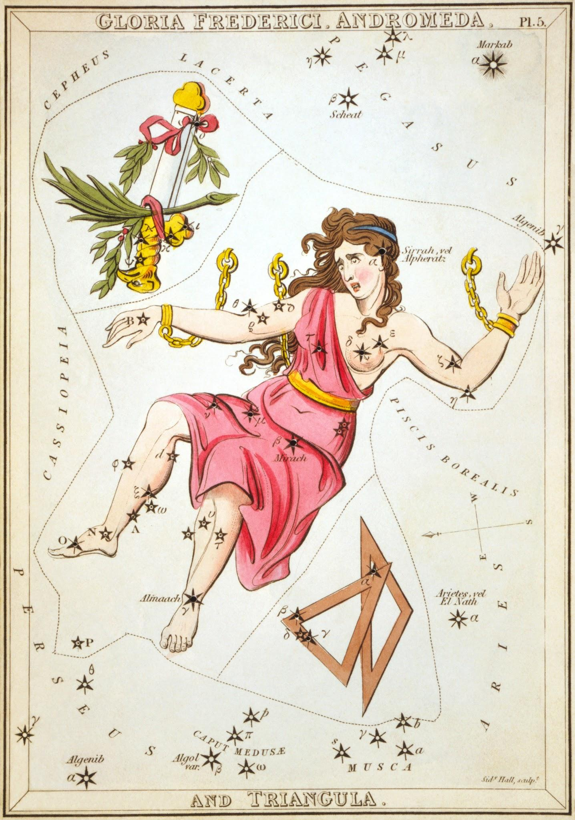
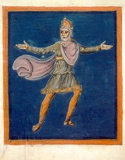
Queen Cassiopeia and King Cepheus of Ethiopia

Slide 3
Daughter: Andromeda
Our daughter is more beautiful than the sea nymphs.

Slide 4
Sea Nymphs →Poseidon
How dare her! I will send a flood and sea monster to destroy Ethiopia!
We are insulted by Queen Cassiopeia. Her daughter is not more beautiful than us!

Slide 5
Cetus: The Sea Monster

Slide 6
King Cepheus Sacrifices His Daughter

Slide 7
Perseus with the head of the Gorgan Medusa

Slide 8
Perseus slew Cetus and saved Andromeda.

Slide 9
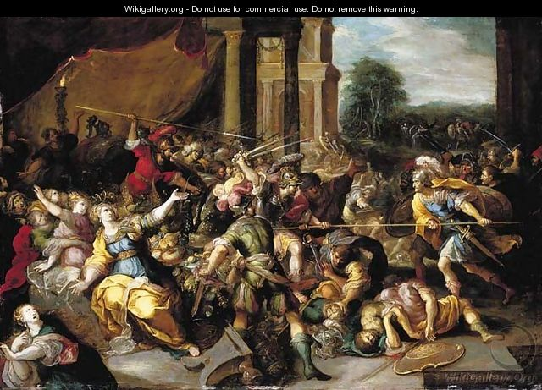
Who will be married to Andromeda?
….Uphold the promise to Perseus?
….Uphold the agreement to Agenor?
There was an epic battle.

Slide 10
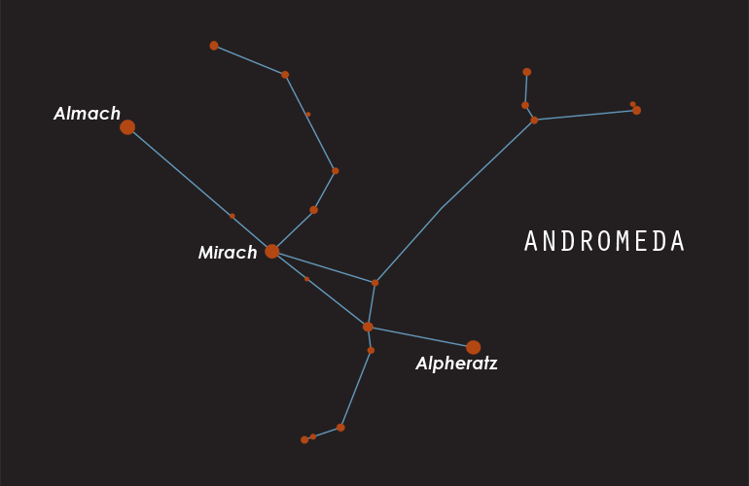
In the end, Andromeda upheld her parents promise to Perseus. As reward for keeping her promise, upon Andromeda’s death, she threw her body among the stars.

Slide 11
Andromeda: More Fact, Less Myth
Constellation Andromeda contains our Galaxy’s companion: Andromeda Galaxy
Can be seen with the naked eye
2.2 million light years away
What kinds of questions do you have about other stars with planets?...other galaxies? etc.

