Slide 1
Engage: Phenomena
Celestial Objects from Different Perspectives
(A Photo Splash)
Georgia Department of Education
May, 2018

Slide 2
Perspectives from Earth

Slide 3
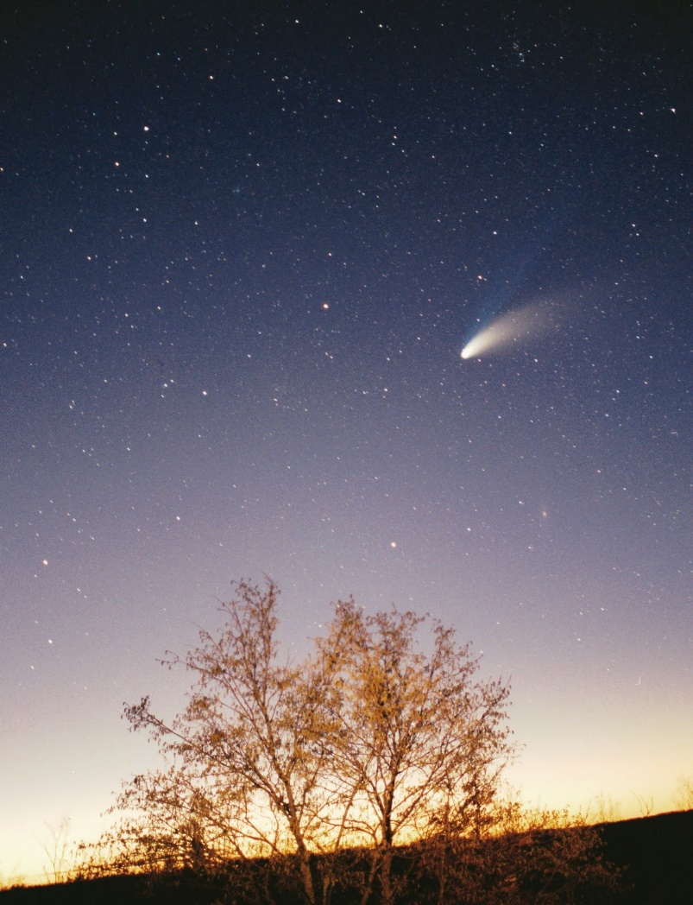
Comets
Notes:
Has anyone ever seen a comet in the sky? Have you ever heard your parents, aunts, uncles, grandparents talk about seeing a comet? How did they describe it?

Slide 4
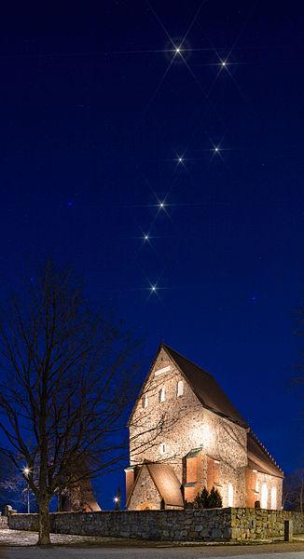
Organization of the Stars
Notes:
Does anyone know what we call this particular shape that the stars in this photo make? Does anyone know other constellations that we can see? (Encourage students to describe whatever they may have observed.)

Slide 5
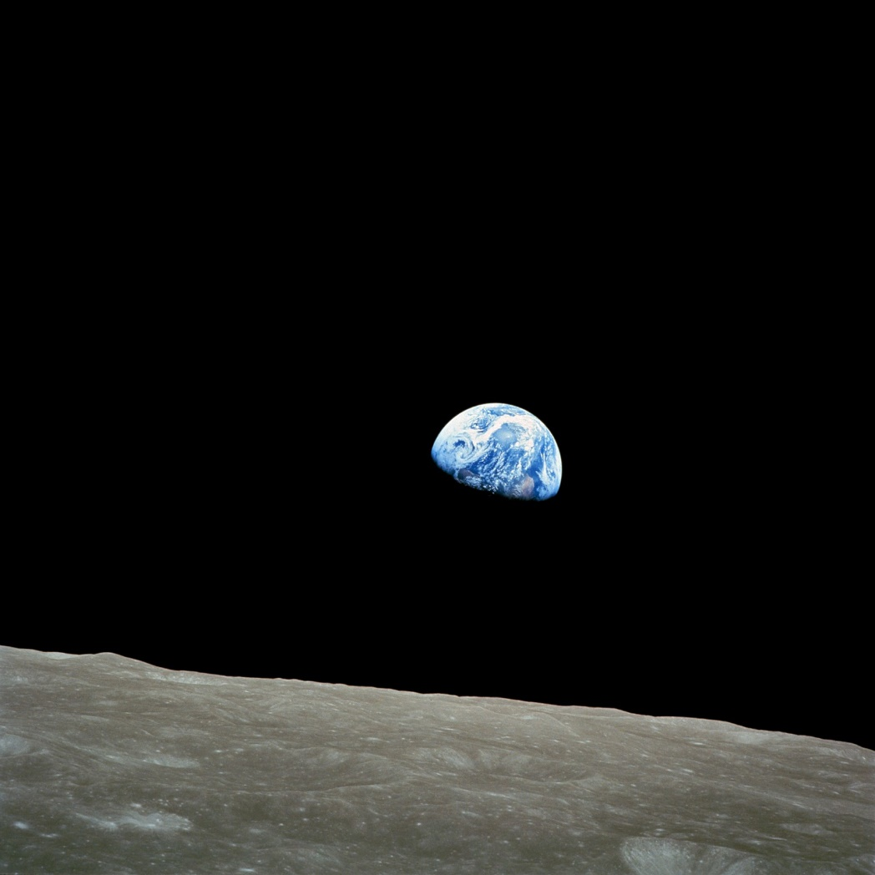
Perspectives from Beyond Earth
Notes:
Has anyone ever ridden an airplane? What kinds of things did you see? Where do you think this photograph was taken? Why do you think only half of the planet is visible?

Slide 6
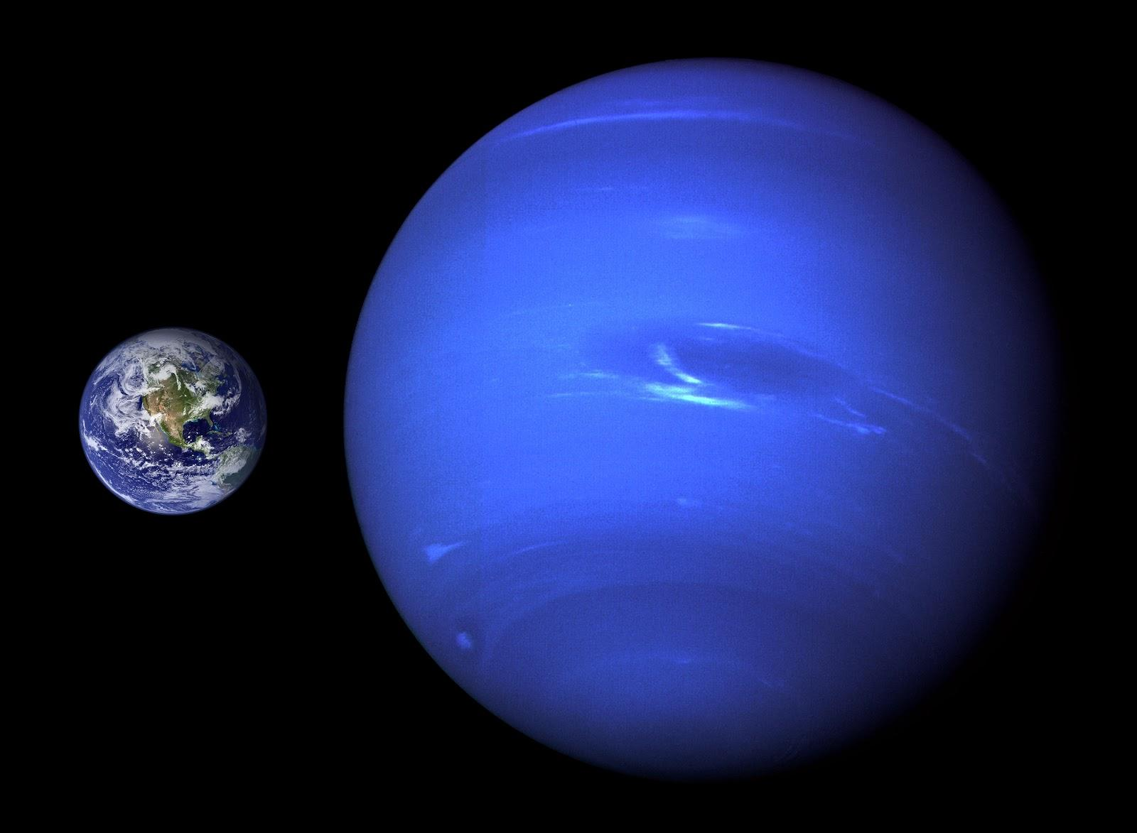
Notes:
How do you think this photograph was taken? Why do you think this closest planet appears blue? Does anyone know the name of this planet? What about the planet furthest away? Why does it seem to be different colors?

Slide 7
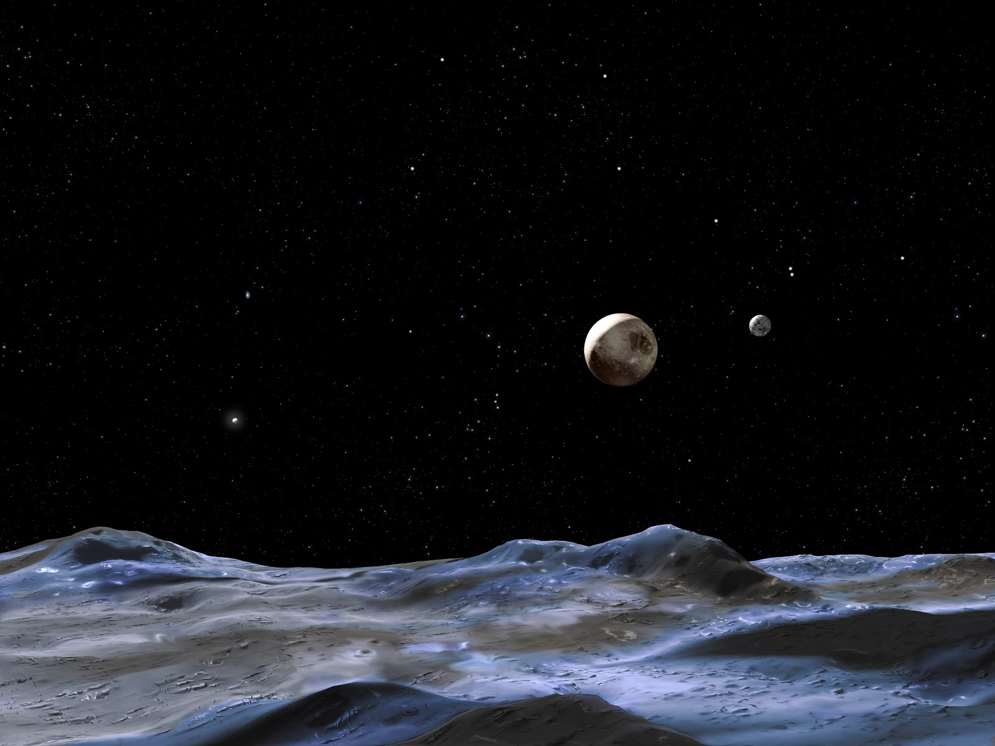
Notes:
What all do you notice in this photograph? What questions does this raise for you?
(Teacher Hint: Write and display student questions as they are generated. Review each of the slides to provide students a chance to ask their own questions. Guide students toward asking questions about the order of planets in the solar system, how objects in the solar system/galaxy/universe came to be organized in a specific way, whether this organization is a constant or changing, etc.)

