Slide 1
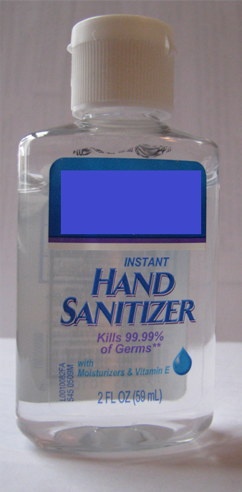
Antibiotic Resistance Mini-Lab
If you look at the label on a container of hand sanitizer, you’ll see that it claims to kill 99.99% of germs (bacteria).
What about the 0.01% that are not killed by the hand sanitizer?
Why did they survive?
What will happen to the population of 0.01% of bacteria that were not killed by hand sanitizer?

Slide 2
Marshmallow/Candy Mini-Lab
Obtain the following materials: 20 mini-marshmallows, 8 pieces of round fruit candy of any color, 1 toothpick, 1 paper plate, 1 paper cup
Put 8 mini-marshmallows and 2 pieces of colored candy on the same plate.
Using ONLY THE TOOTHPICK, pick up the mini-marshmallows or pieces of candy ONE AT A TIME and place them in the cup. Pick up as many as possible in 7 seconds.
Count how many are remaining and record this data in the table below.
The remaining mini-marshmallows and candy pieces will now undergo reproduction by fission. Double the amount of mini-marshmallows and candy pieces on the plate.
Repeat steps 3-5 twice for a total of 3 rounds and record all data in the table below.

Slide 3
Make a line graph showing the results of your table.
Marshmallow
(Normal)
16
14
12
10
8
6
4
2
0
Candy
(Mutated)
Number of Bacteria
0
D1
R1
D2
R2
D3
R3
Time

Slide 4
Conclusion Questions
What does the paper plate represent?
Your hand
What do the white mini-marshmallows represent?
Normal (non-mutated) bacteria on your hand
What do the pieces of candy represent?
Resistant (mutated) bacteria on your hand
What does the process of removing them represent?
Putting a dose of hand-sanitizer on your hand
What does the process of doubling the amount left represent?
The surviving bacteria reproduce to form another generation
Does this change your view on using hand sanitizer?

Slide 5
Conclusion Questions
What was the mutation and where did it come from?
Hard shell from a random genetic mutation
Where do you see the four points of Darwin’s theory of natural selection?
Competition
Bacteria were competing for resources (space on hand)
Variation
Two different bacteria (soft shell and hard shell)
Survival of the Fittest
Soft shells were easy to remove so hard shells survived
Reproductive Success
Hard shells were able to reproduce and population shifted

Slide 6
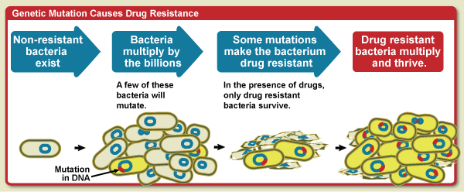
Describe how the following image relates to the mini-lab.

Slide 7
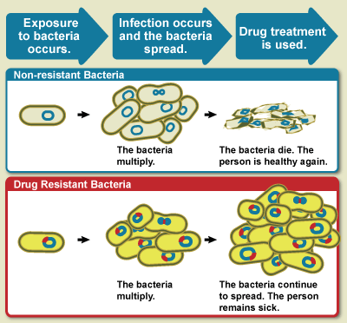
Describe how the following image relates to
real-world scenarios of antibiotic resistance.

