Slide 1
GSE Primary Source Documents
Unit One: Connecting Themes

Slide 2
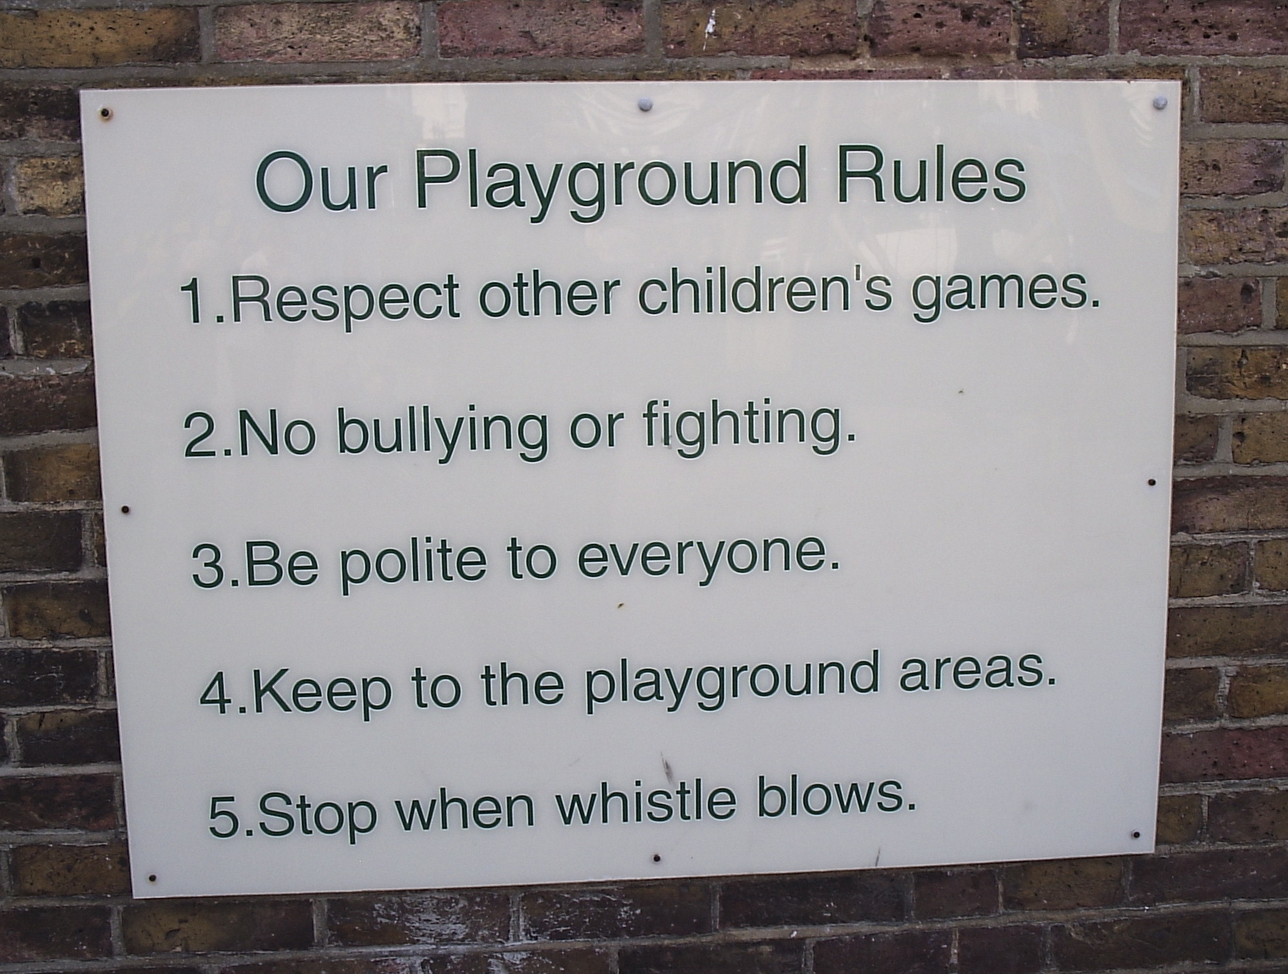
Why do we have rules and laws? How are the rules at home and school different? How are you responsible at at home and school?
Distribution of Power: The student will understand that distribution of power in government is a product of existing documents and laws combined with contemporary values and beliefs.
Source:
Google Images

Slide 3
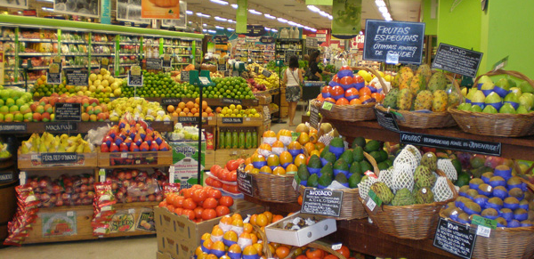
How do we buy the things we want and need? Where do those goods and services come from? What products are grown or made in Georgia?
Production, Distribution, and Consumption:
The student will understand that the production, distribution, and consumption of goods/services produced by the society are affected by the location, customs, beliefs, and laws of the society.
Source:
Wkipedia

Slide 4
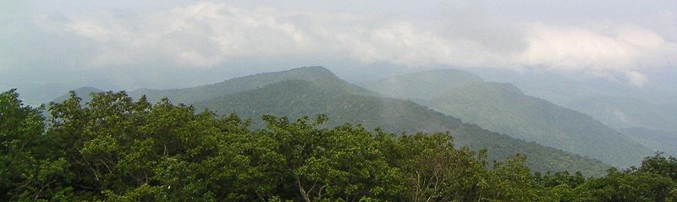
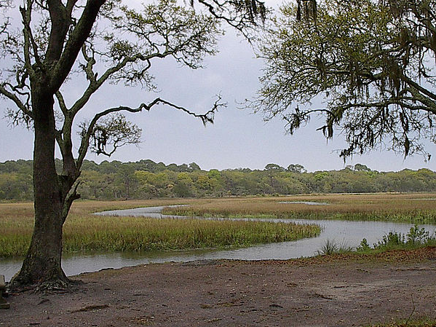
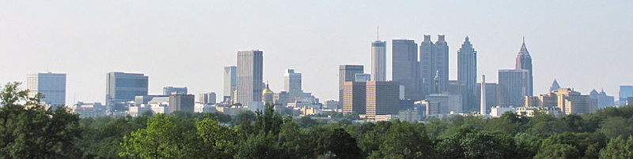
What do you notice? How are these places alike and different? Why do people live in different parts of Georgia?
Location:
The student will understand that location affects a society’s economy, culture, and development.
Source:
Wikipedia

Slide 5
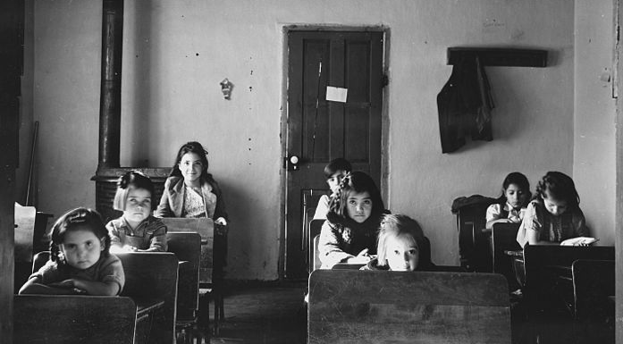
How is the life of these children different from your life? How have things changed since these children were in school?
Time, Change, and Continuity:
The student will understand that while change occurs over time, there is continuity to the basic structure of society.
Source:
Wikipedia

Slide 6
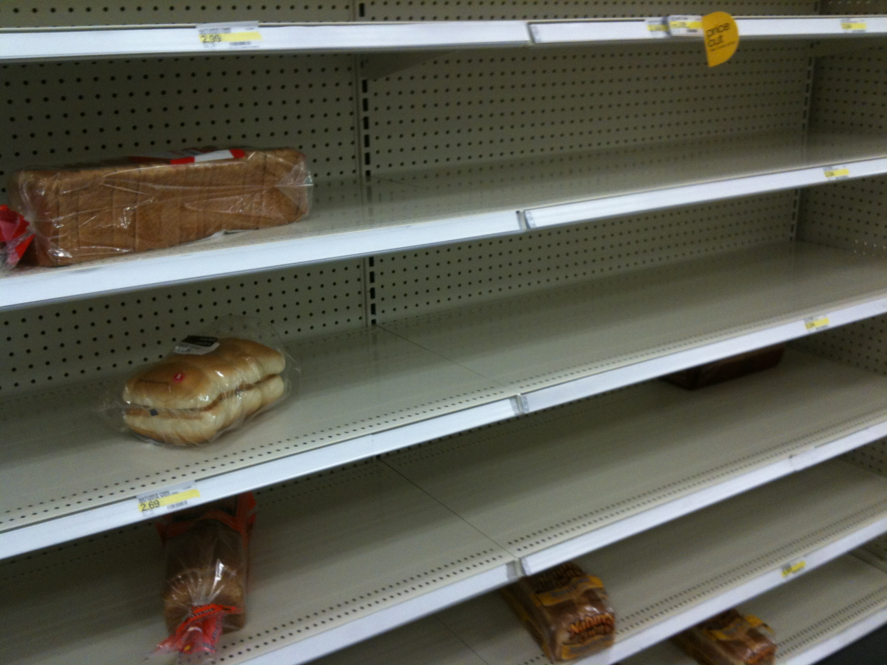
What do you notice? What do you do if something you want is not available? How do we manage our time and resources?
Scarcity:
The student will understand that scarcity of all resources forces parties to make choices and that these choices always incur a cost.
Source:
Google Images

