Slide 1
GSE Primary Source Documents
Unit Two: Our Georgia

Slide 2
Who are these people? Where do they work? why is that location important?
SS2CG2: Identify the following elected officials of the executive branch and where they work: President, Governor, mayor
Insert photos of the current president, governor, and your local mayor on this slide before introducing to your students.

Slide 3
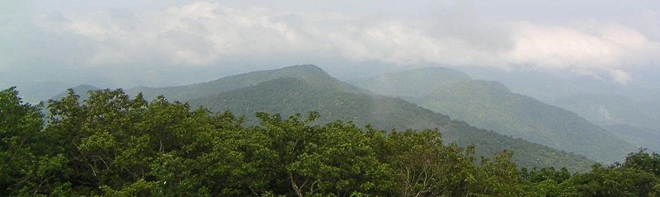
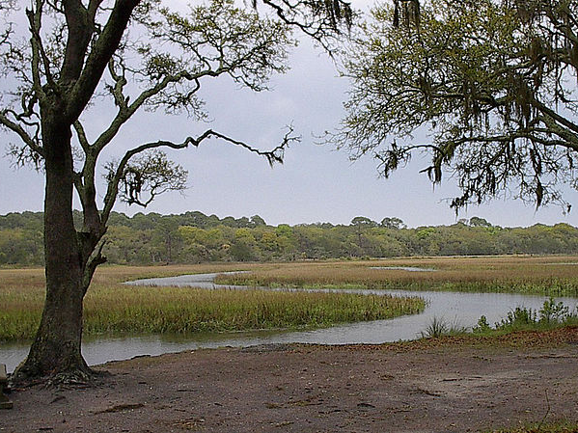
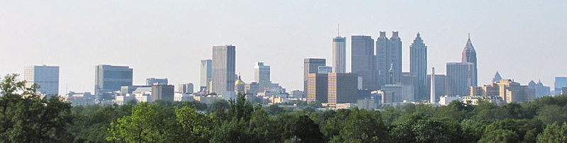
In what ways are the regions of Georgia similar and different?
S2G1: Locate and compare major topographical features of Georgia and describe how these features define Georgia’s surface.
a. Locate and compare the geographic regions of Georgia: Blue Ridge, Piedmont, Coastal Plain, Ridge and Valley, and Appalachian Plateau.
Source:
Google Images
Source:
Google Images

Slide 4
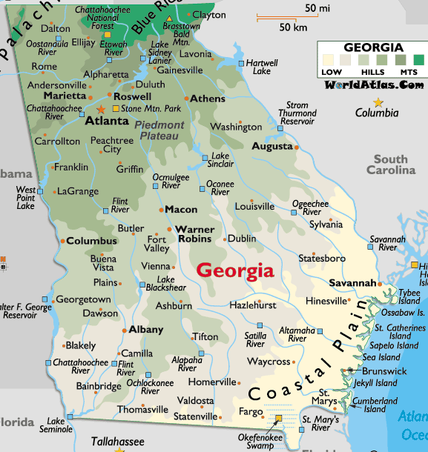
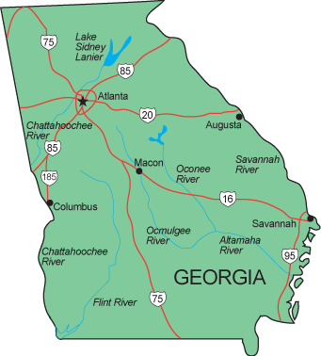
Why are many of Georgia’s cities and towns built near rivers?
S2G1: Locate and compare major topographical features of Georgia and describe how these features define Georgia’s surface.
b. Locate on a physical map the major rivers: Savannah, Flint, and Chattahoochee.
Source:
State-maps.org
Source:
Graphicmaps.com

Slide 5
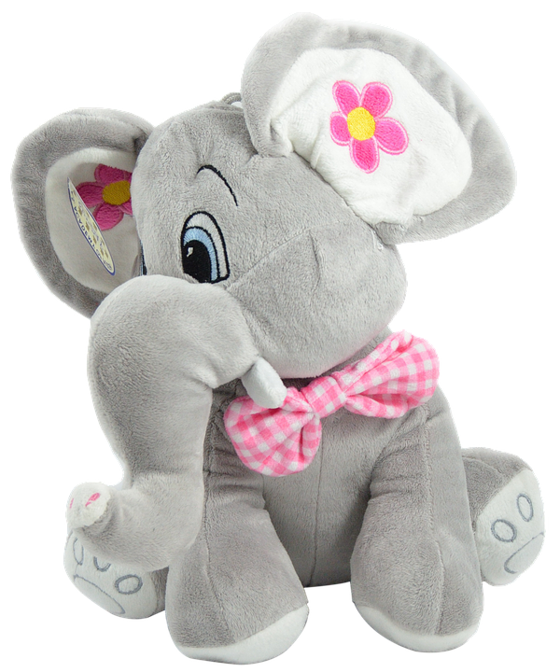
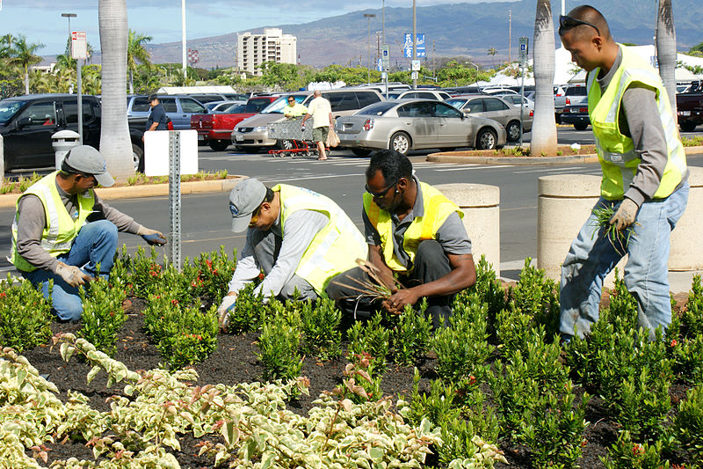
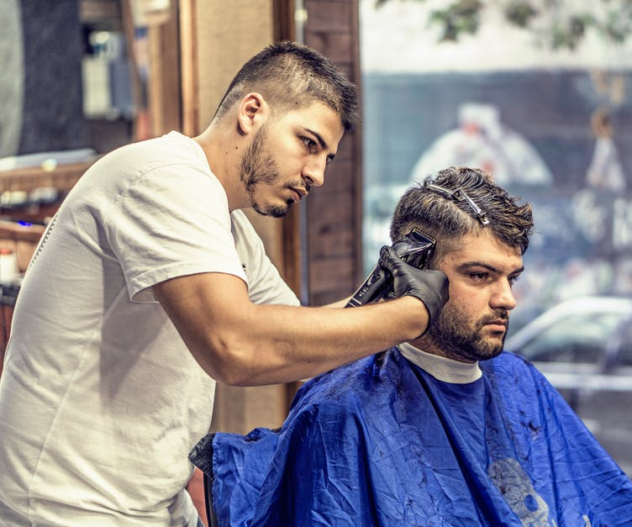
How are these pictures similar and different? How are goods and services different?
SS2E2: Identify some ways in which goods and services are allocated.
Source:
Google Images
Source:
Google Images

