Slide 1
GSE Primary Source Documents
Unit Three: Georgia’s First People

Slide 2
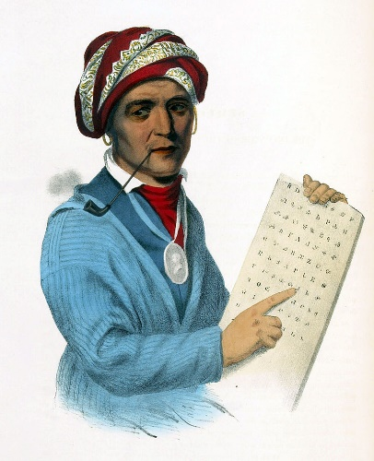
Who is this? How do you think he influenceD the lives of the Cherokee?
SS2H1: Describe the lives and contributions of historical figures in Georgia history
Source:
Wikipedia

Slide 3
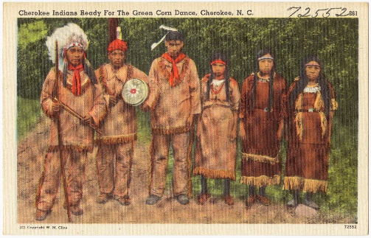
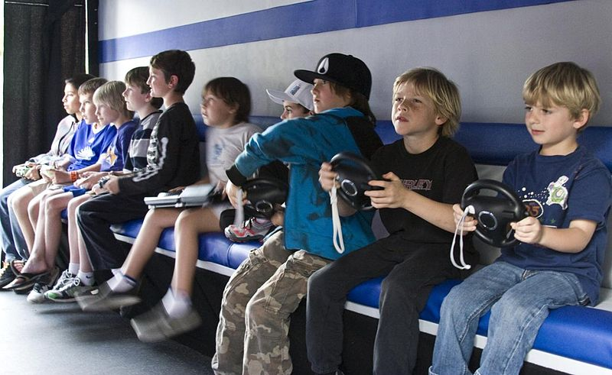
How are these pictures similar and different?
SS2H2: Describe the Georgia Creek and Cherokee cultures of the past
Source:
Wikipedia

Slide 4
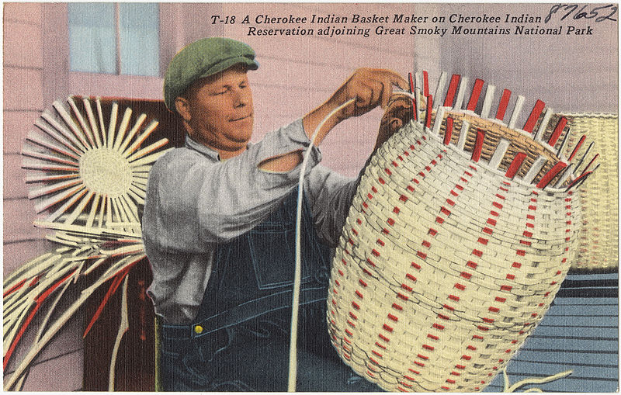
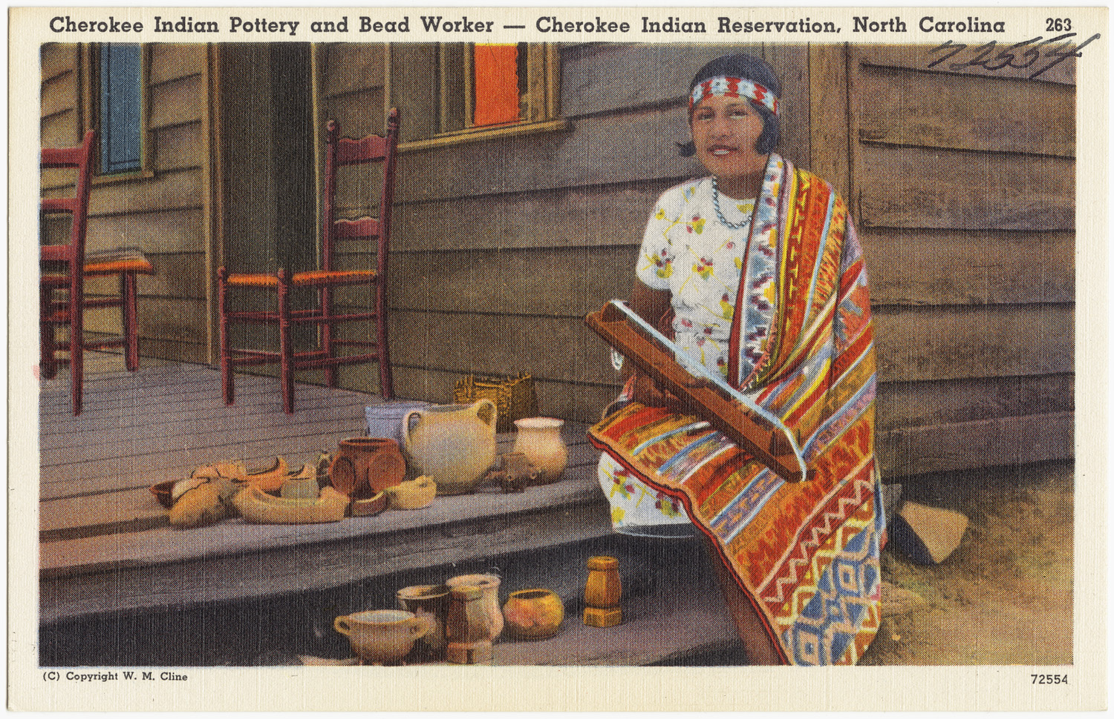
In what ways is your life Today similar and different from the lives of the Early Cherokee and Creek?
SS2G2: Describe the cultural and geographic systems associated with the historical figures in SS2H1 & SS2H2.
Source:
Wikipedia

Slide 5
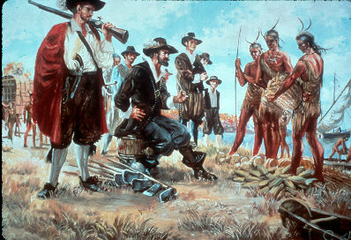
What is happening in this picture? How did the creek and Cherokee get the things they needed to survive?
SS2E1: Explain that because of scarcity, people must make choices that result in opportunity costs.
Source:
Nps.gov

