Slide 1
Grade 5, Unit 2 Document Set/ppt
Sections of this ppt correspond to learning activities:
  Rights and Responsibilities
  Amending the Constitution
  Consuming and Producing Goods and Services
  Big Business & the Government

Slide 2
Rights and Responsibilities

Slide 3

Obey Laws

Slide 4

Pay Taxes

Slide 5

Get an Education

Slide 6
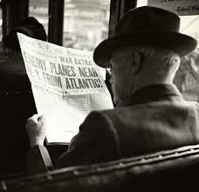
Stay Informed

Slide 7

Own Property

Slide 8
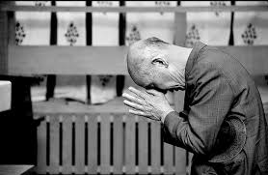
Worship

Slide 9

Defend the Country

Slide 10
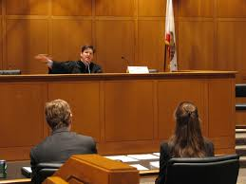
Have a Fair Trial

Slide 11
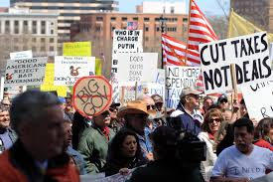
Protest

Slide 12
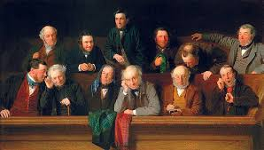
Serve on a Jury

Slide 13

Vote

Slide 14
Amending the Constitution

Slide 15
Amending the Constitution
How do we change the Constitution?

Slide 16

Step 1
Congress proposes a new amendment.
2/3 of the Senate pass the bill
2/3 of the House of Representatives pass the bill
+

Slide 17
Step 2
Proposed amendment is sent to the states

Slide 18


Step 3
State legislatures choose
to ratify (accept) or reject the amendment

Slide 19

Step 4
¾ of the states must ratify the amendment for it to be added to the Constitution
¾

Slide 20
Why do so many people have to vote to amend the Constitution?
So that small groups cannot make changes that most people do not want!

Slide 21
Consuming & Producing Goods and Services

Slide 22
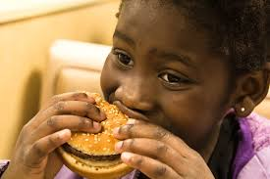
Eating a Hamburger

Slide 23
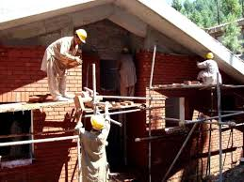
Building a House

Slide 24
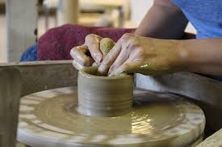
Making a Vase

Slide 25
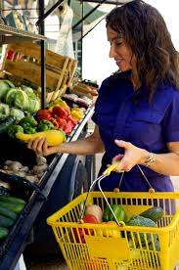
Buying Groceries

Slide 26
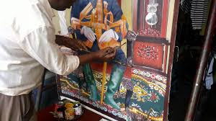
Painting a Picture

Slide 27
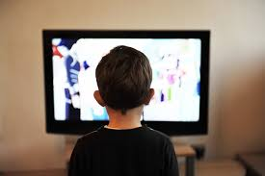
Watching TV

Slide 28
Big Business & the Government

Slide 29


Slide 30


Slide 31


Slide 32


Slide 33


Slide 34


