Slide 1
Unit 5 Source Set
SSUSH8 Explore the relationship between slavery, growing north-south divisions, and westward expansion that led to the outbreak of the Civil War.
SSUSH9 Evaluate key events, issues, and individuals related to the Civil War
SSUSH10 Identify legal, political, and social dimensions of Reconstruction.

Slide 2
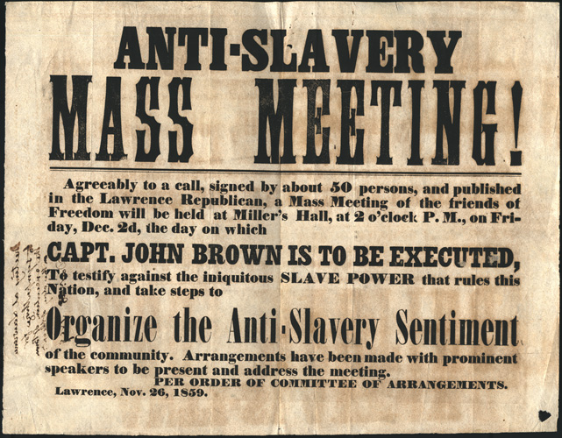
John Brown’s Address to the Court before hearing his sentence
“. . . I believe to have interfered as I have done, . . . in behalf of His despised poor, was not wrong, but right. Now, if it be deemed necessary that I should forfeit my life for the furtherance of the ends of justice, and mingle my blood further with the blood of my children, and with the blood of millions in this slave country whose rights are disregarded by wicked, cruel, and unjust enactments, I submit: so let it be done."
http://www.pbs.org/wgbh/aia/part4/4p1550.html
http://www.lva.virginia.gov/public/guides/Civil-War/John-Brown.htm

Slide 3
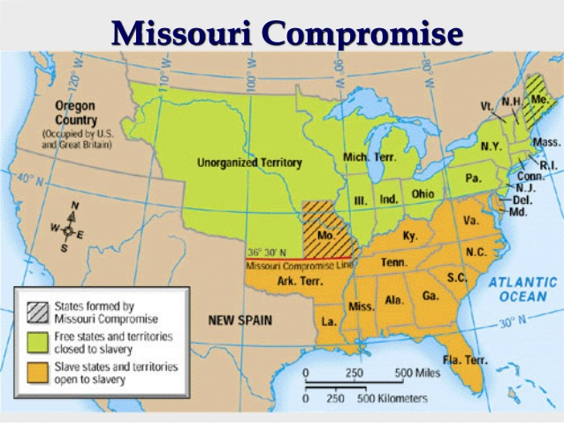
Source: http://image.slidesharecdn.com/1850s-roadtosecession-110105065131-phpapp01-141007132119-conversion-gate02/95/1850s-roadtosecession110105065131phpapp01-11-638.jpg?cb=1412688096

Slide 4
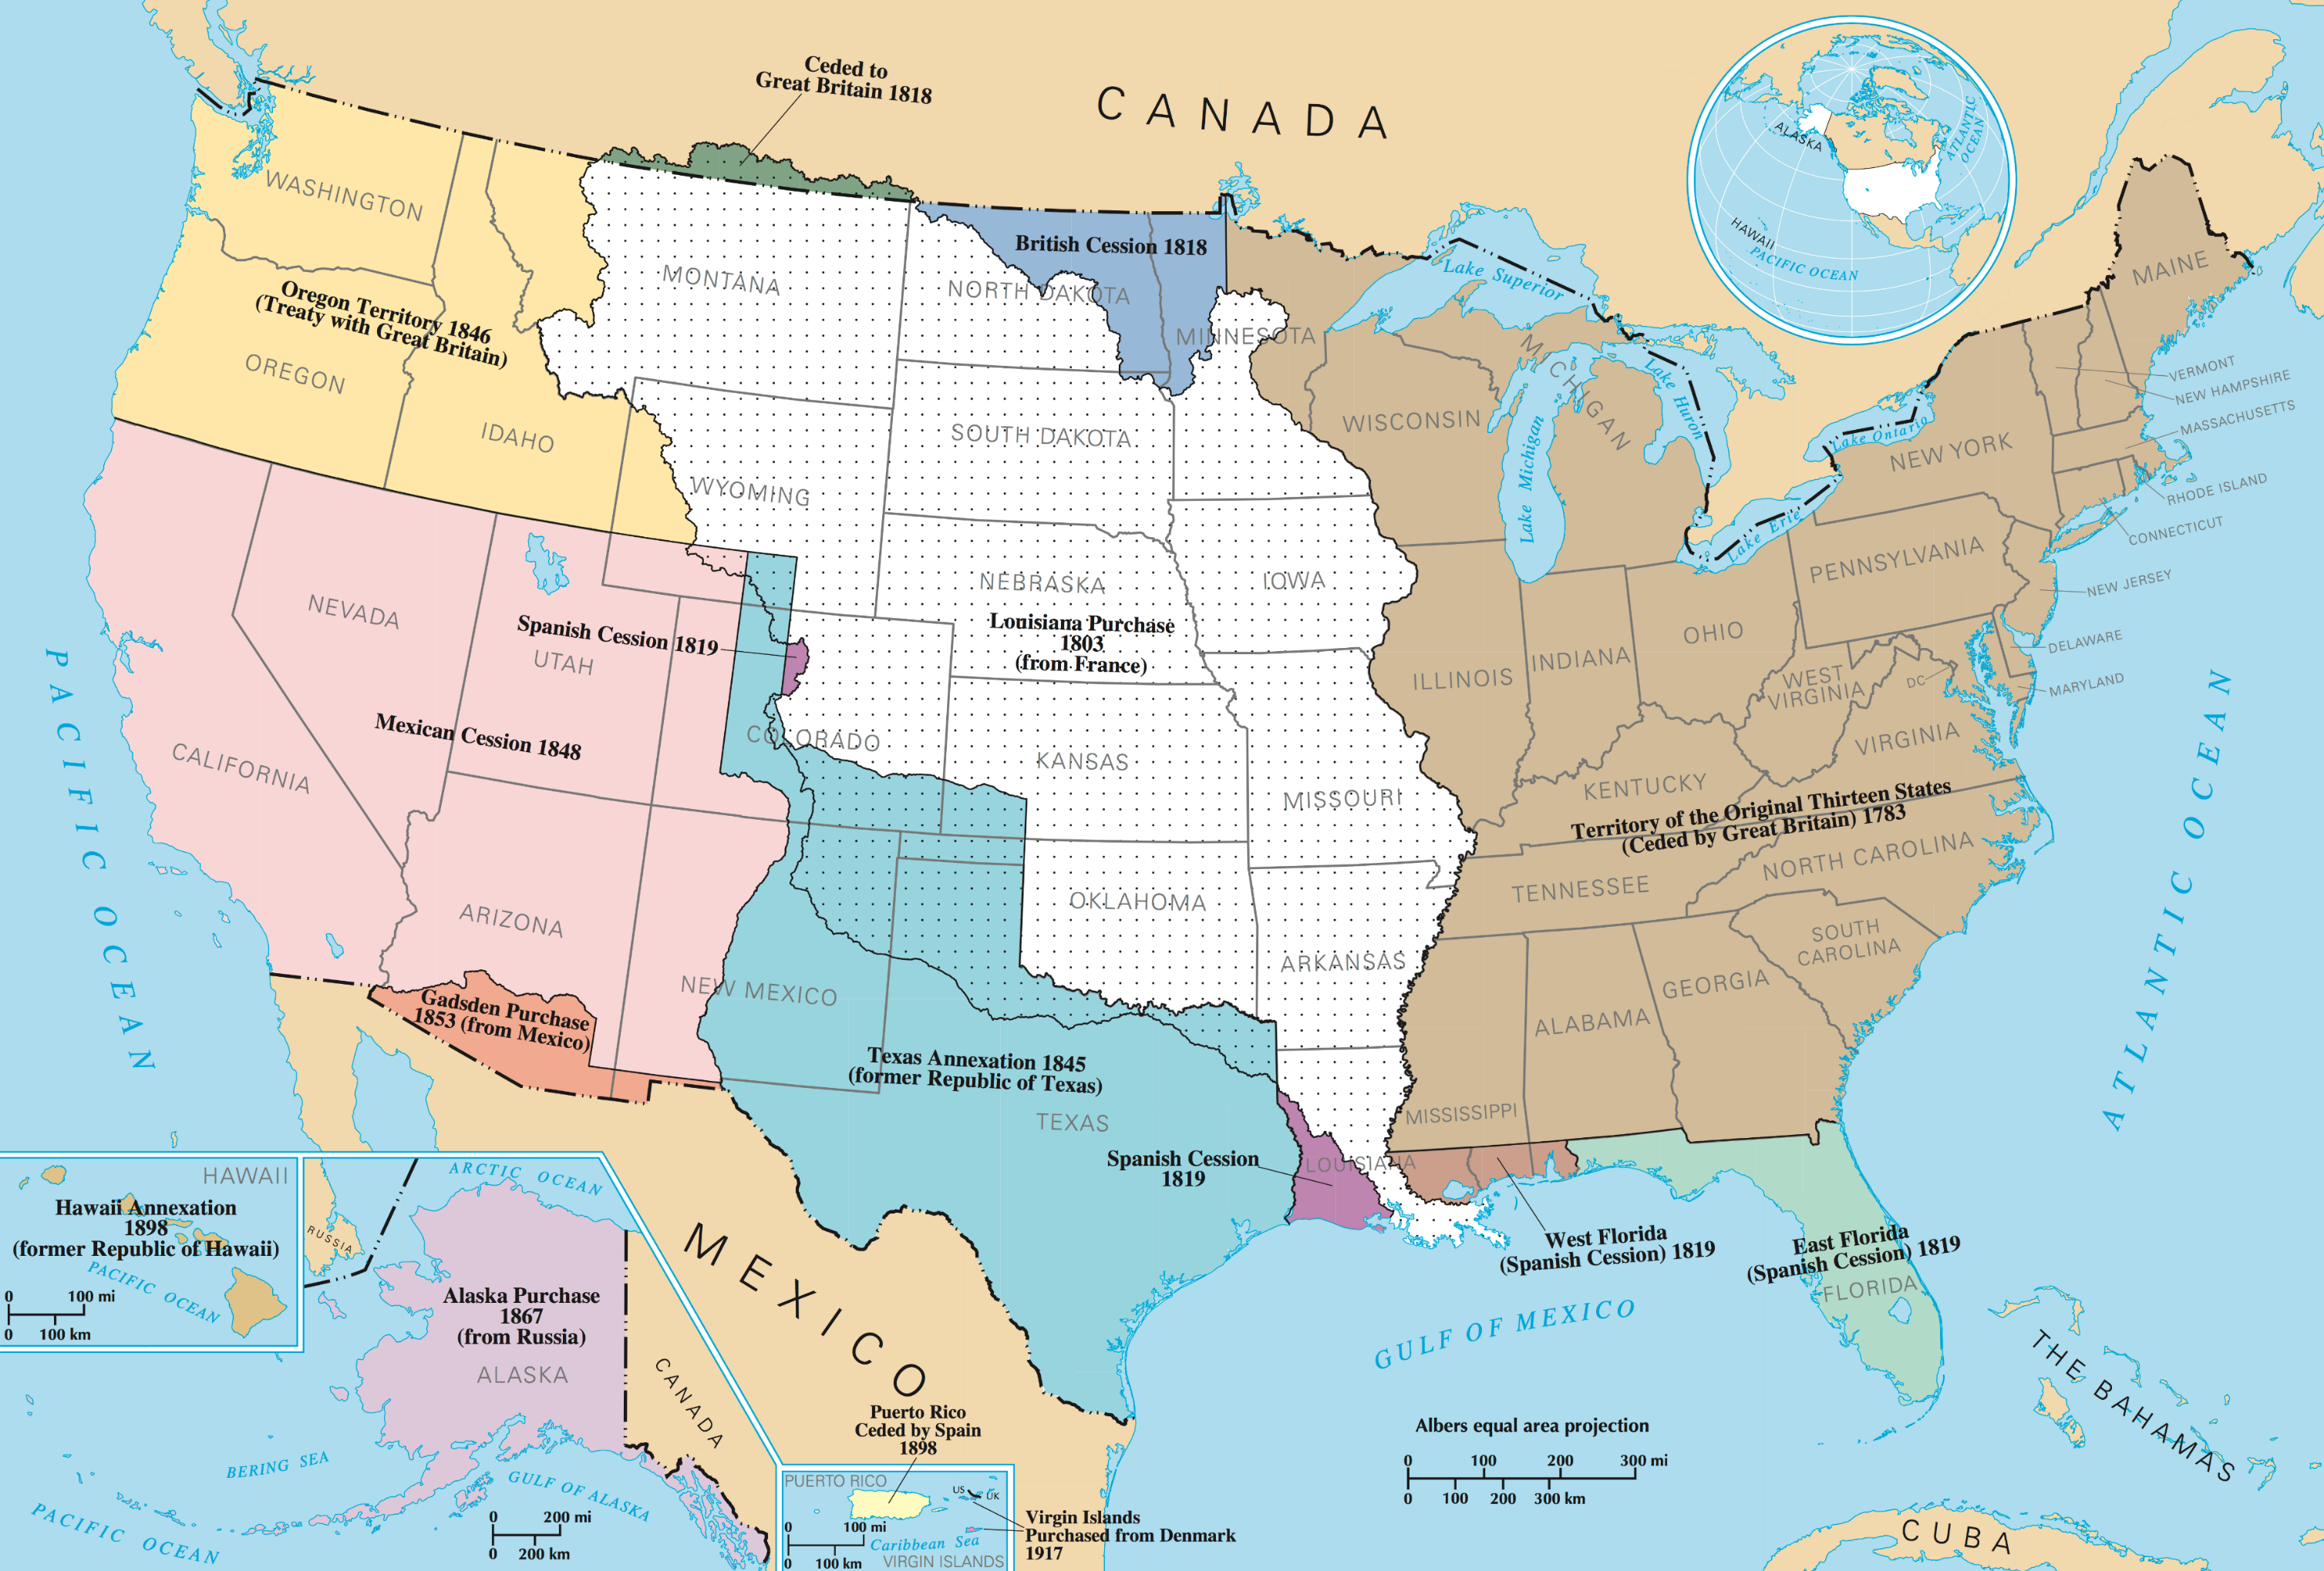
Manifest Destiny
Source: https://upload.wikimedia.org/wikipedia/commons/2/29/UnitedStatesExpansion.png

Slide 5
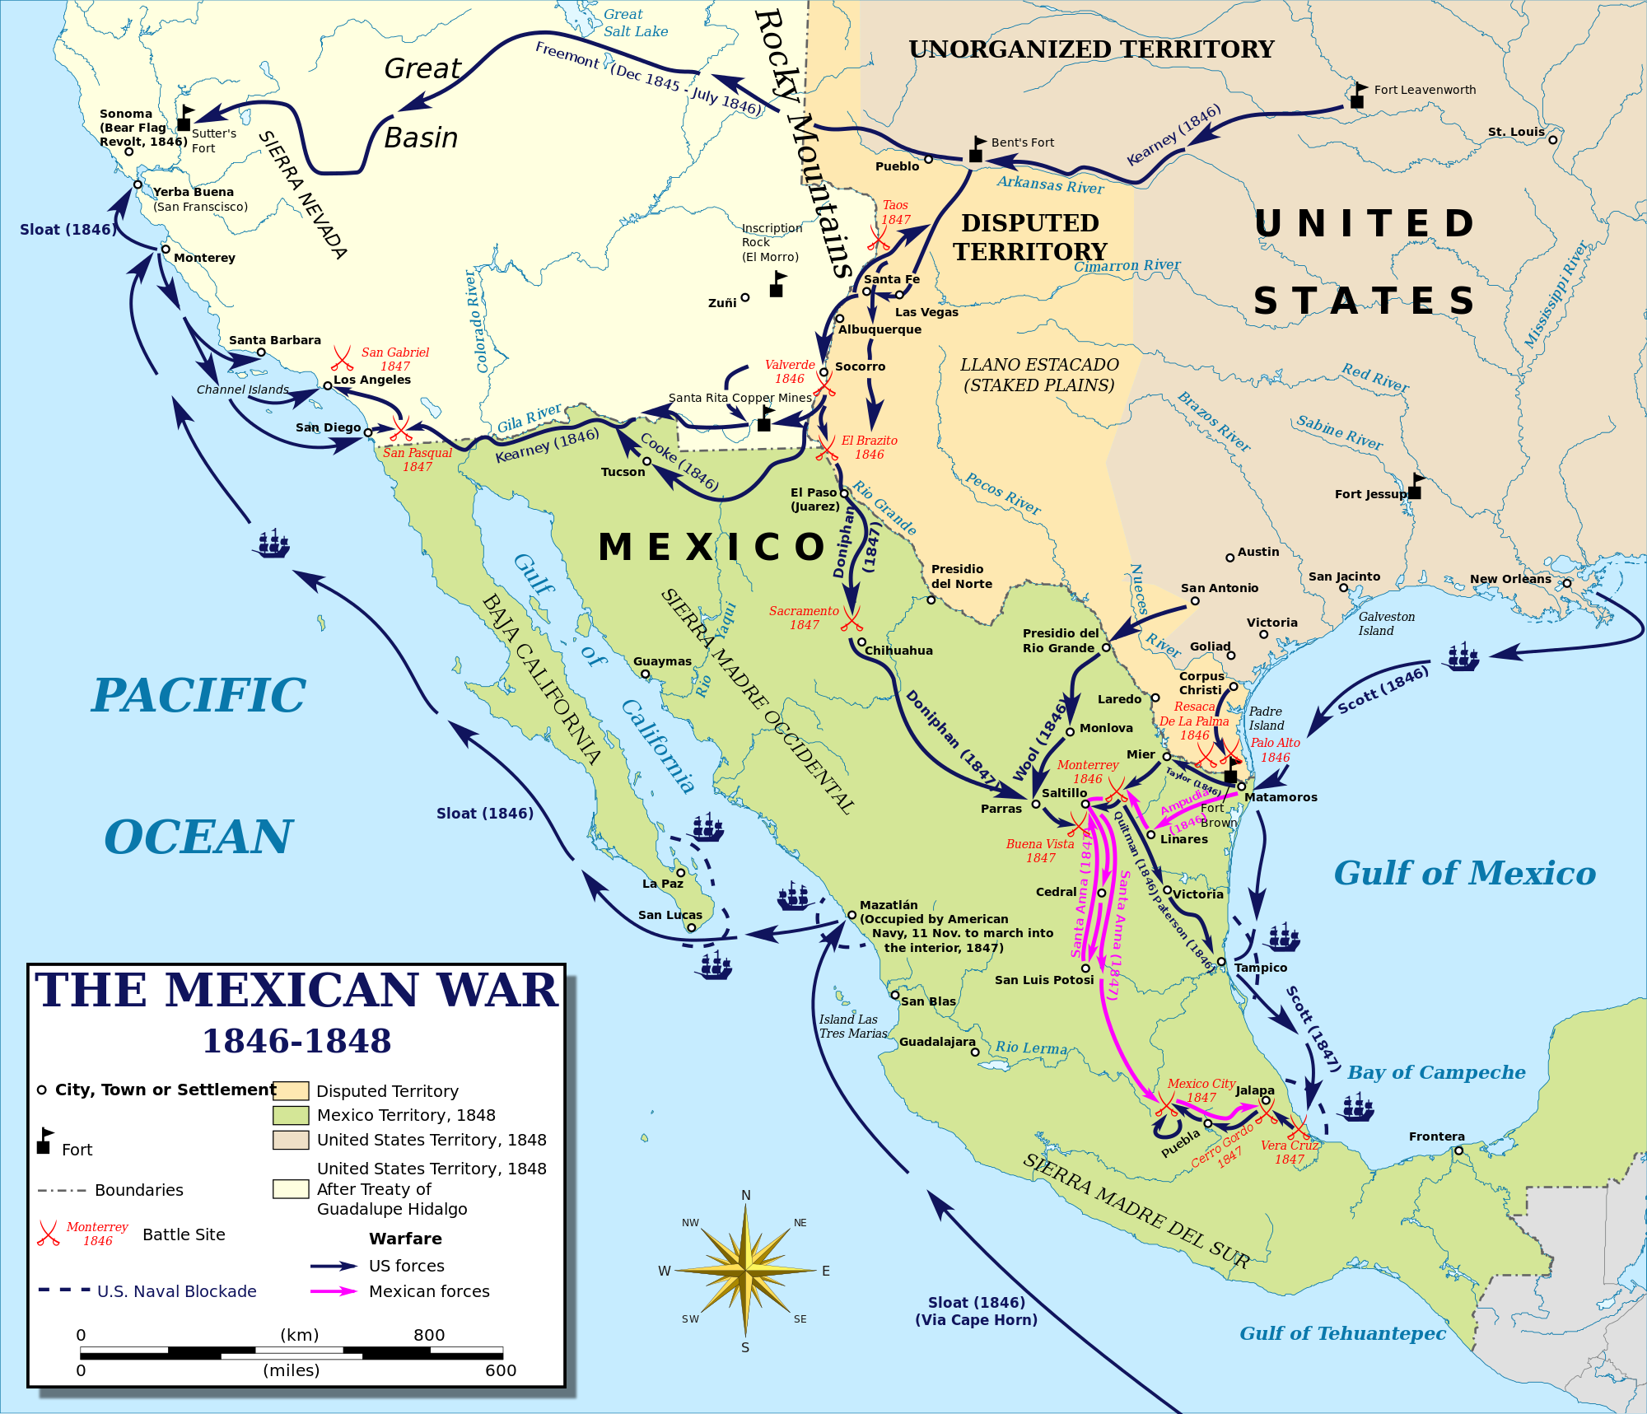
Source: https://upload.wikimedia.org/wikipedia/commons/thumb/0/0b/Mexican%E2%80%93American_War_(without_Scott's_Campaign)-en.svg/2000px-Mexican%E2%80%93American_War_(without_Scott's_Campaign)-en.svg.png

Slide 6
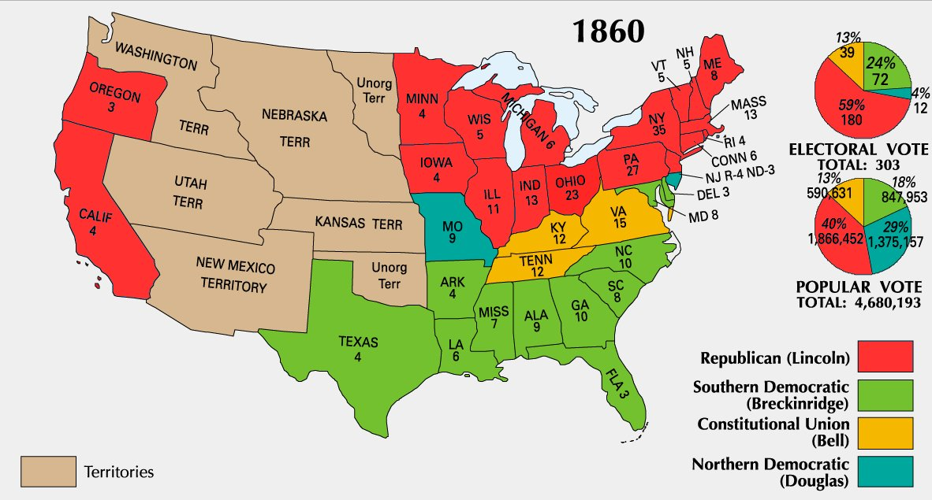
Election of 1860
Source: https://upload.wikimedia.org/wikipedia/commons/d/d3/1860_Electoral_Map.jpg

Slide 7
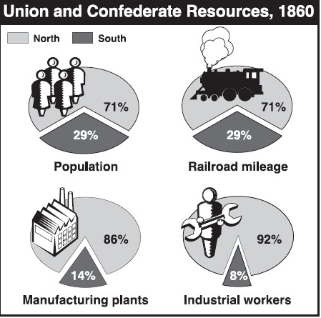
Disparity between the North and the South
http://users.humboldt.edu/ogayle/hist110/unit4/CivilWar.html

Slide 8
1861 Cartoon map illustrating Gen. Winfield Scott's plan to crush the Confederacy, economically. It is sometimes called the "Anaconda plan."
https://en.wikipedia.org/wiki/Anaconda_Plan#/media/File:Scott-anaconda.jpg

Slide 9
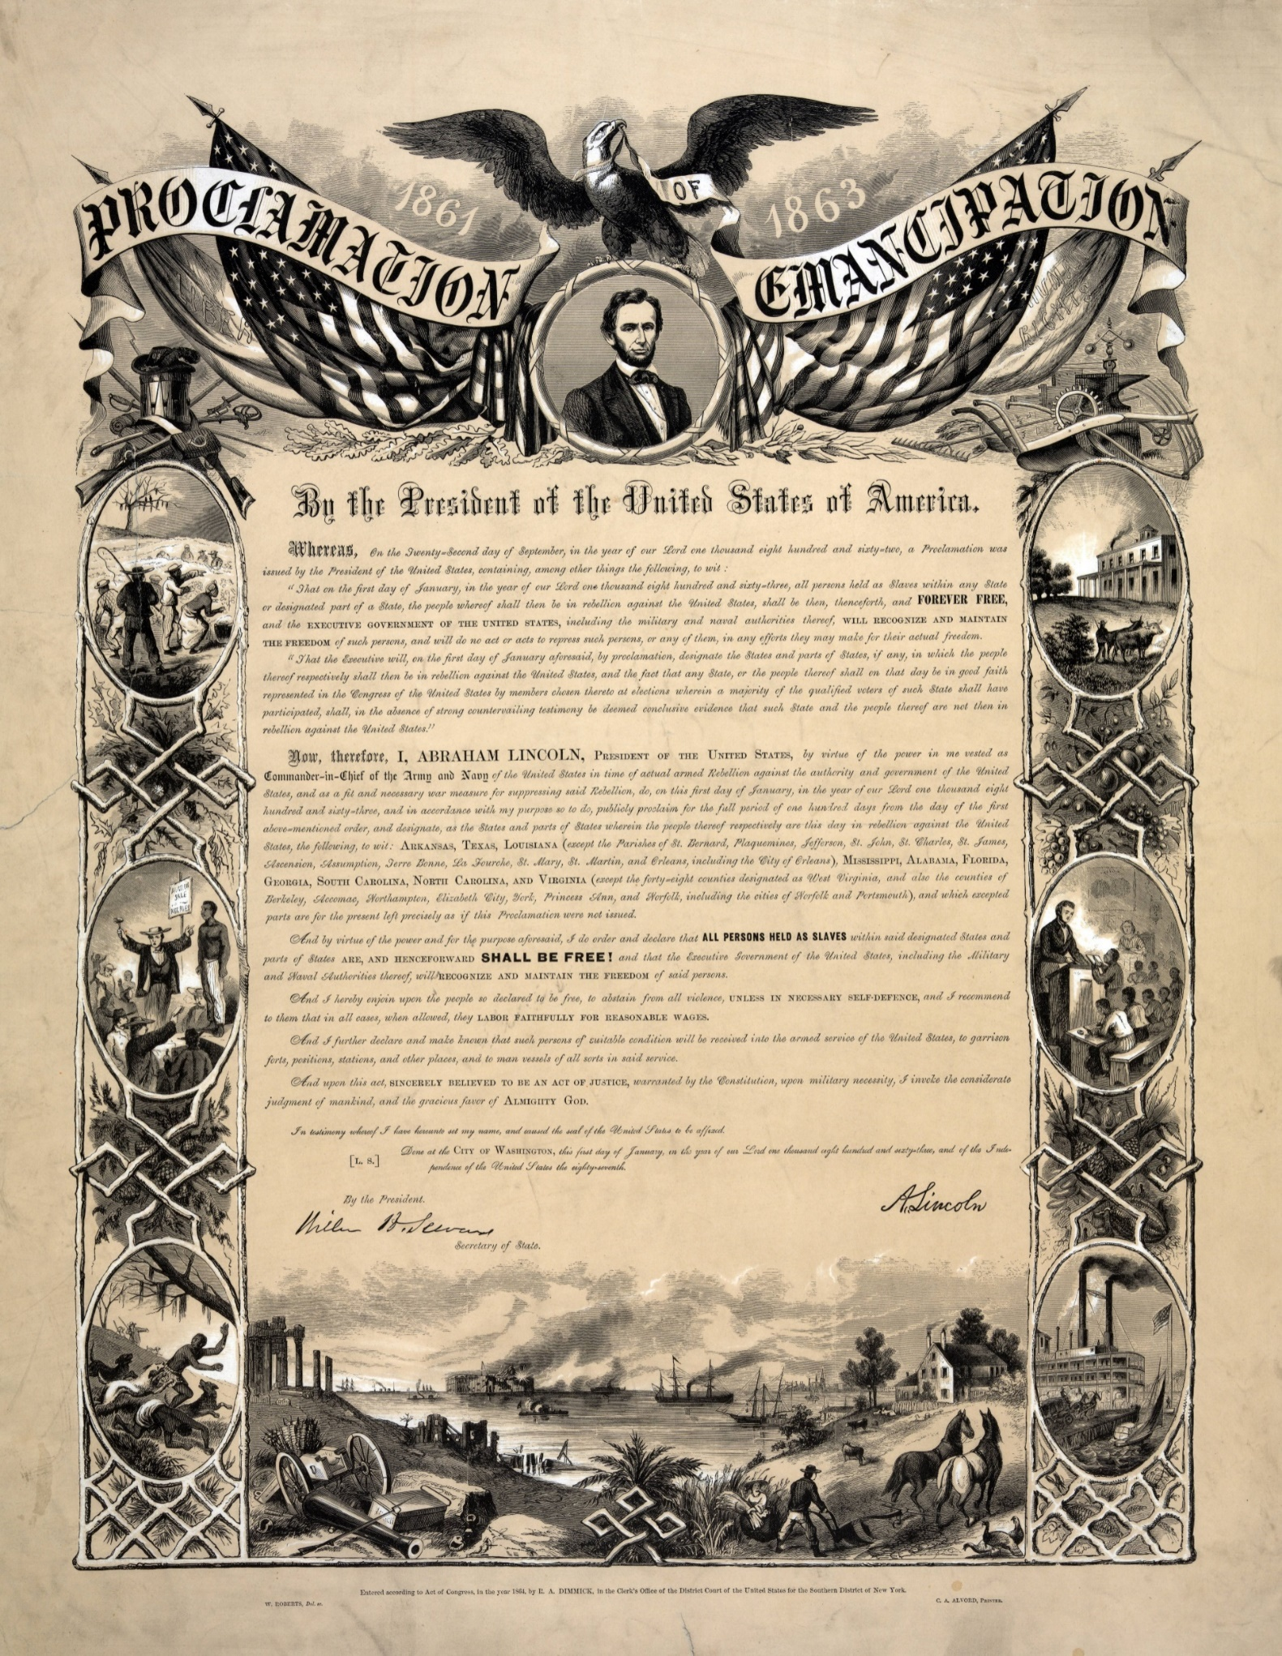
Emancipation Proclamation
Source: https://upload.wikimedia.org/wikipedia/commons/f/f9/Emancipation_Proclamation.jpg

Slide 10
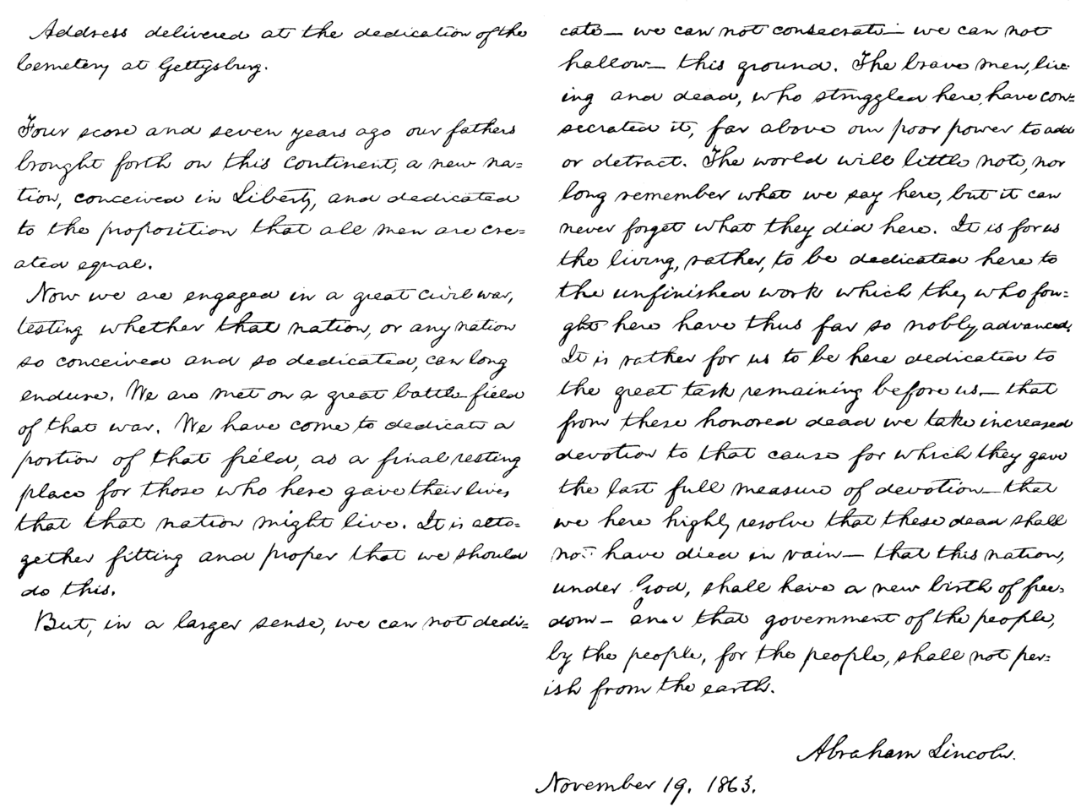
Gettysburg Address
Source: https://upload.wikimedia.org/wikipedia/commons/thumb/9/96/Presidents_Abraham_Lincoln_Gettysburg_address.png/1280px-Presidents_Abraham_Lincoln_Gettysburg_address.png

Slide 11
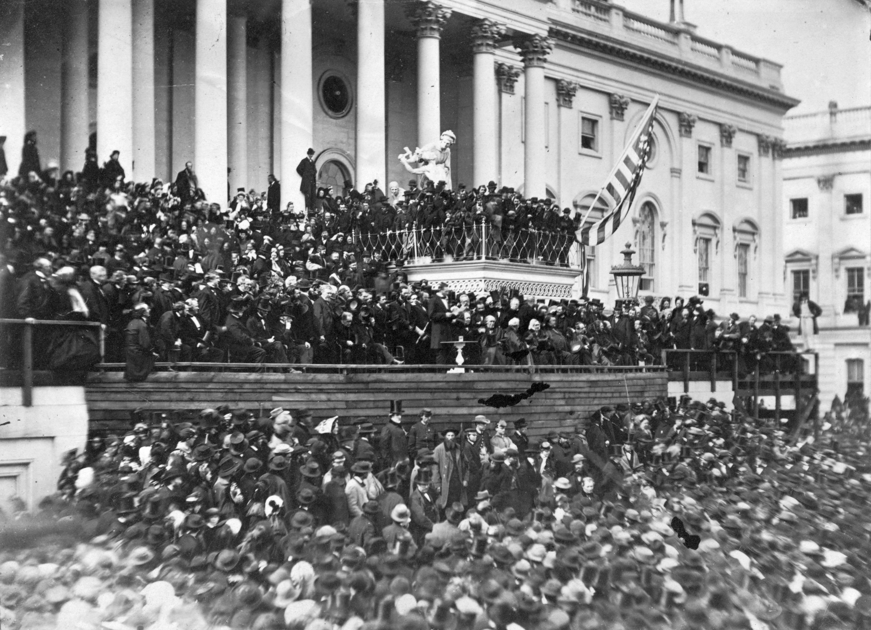
Lincoln Delivers the Second Inaugural Address
Source: https://upload.wikimedia.org/wikipedia/commons/5/5c/Abraham_Lincoln_second_inaugural_address.jpg

Slide 12
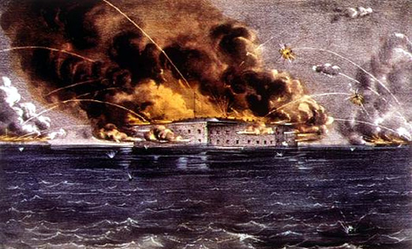
Battle of Fort Sumter
Source: https://upload.wikimedia.org/wikipedia/commons/0/05/Sumter.jpg

Slide 13
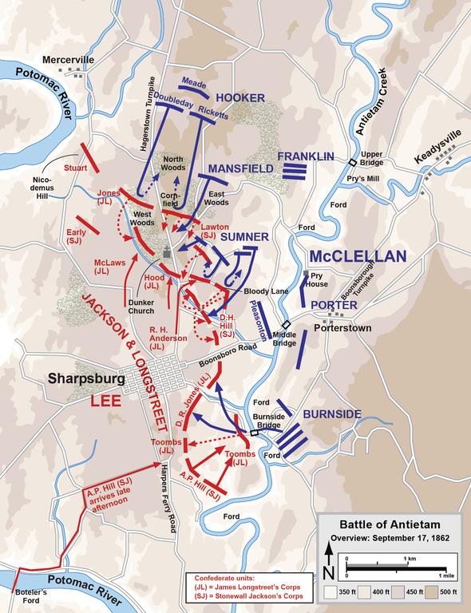
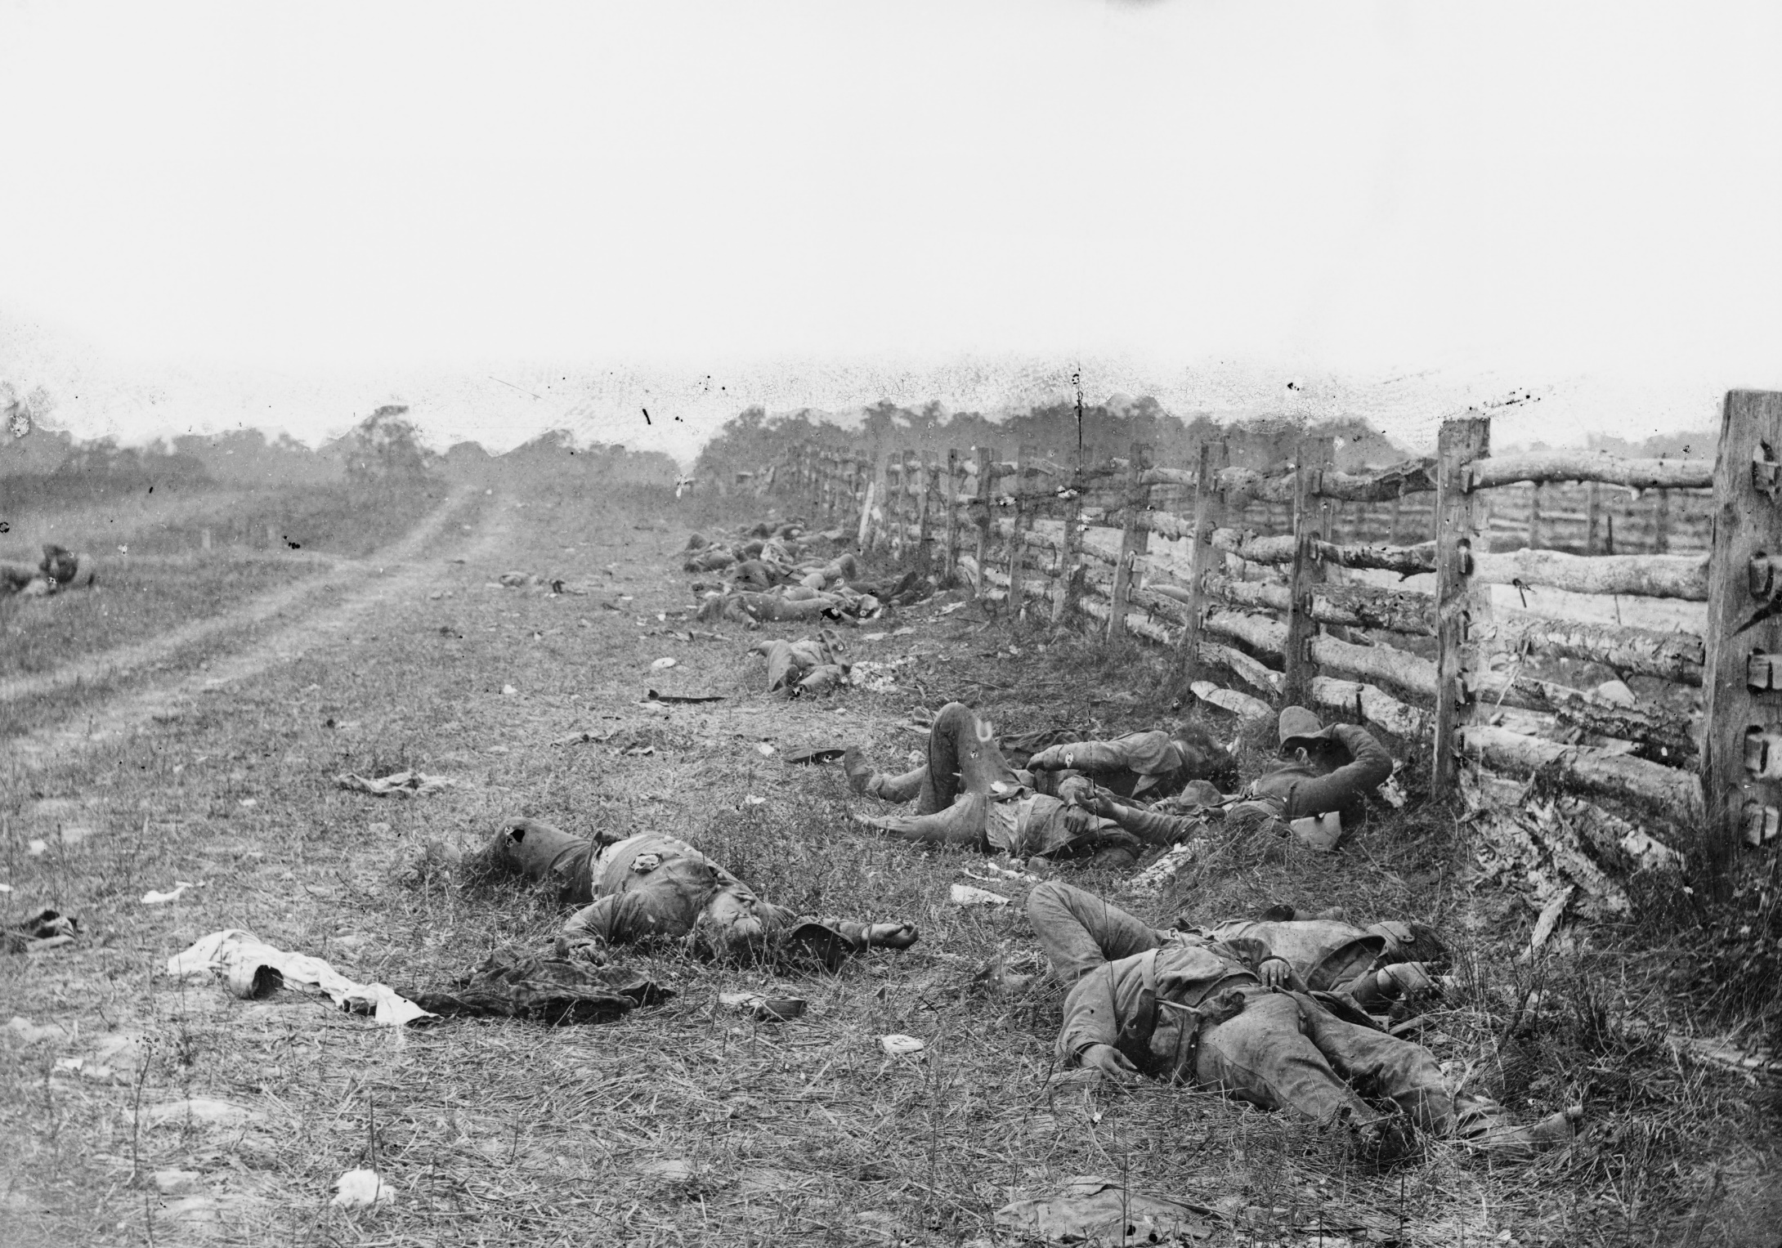
Battle of Antietam
Source: https://upload.wikimedia.org/wikipedia/commons/9/9e/Bodies_on_the_battlefield_at_antietam.jpg
Source: https://upload.wikimedia.org/wikipedia/commons/thumb/1/1b/Antietam_Overview.png/590px-Antietam_Overview.png

Slide 14
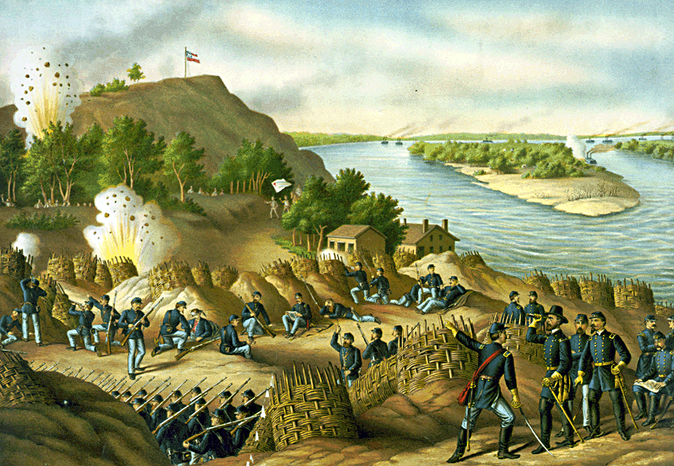
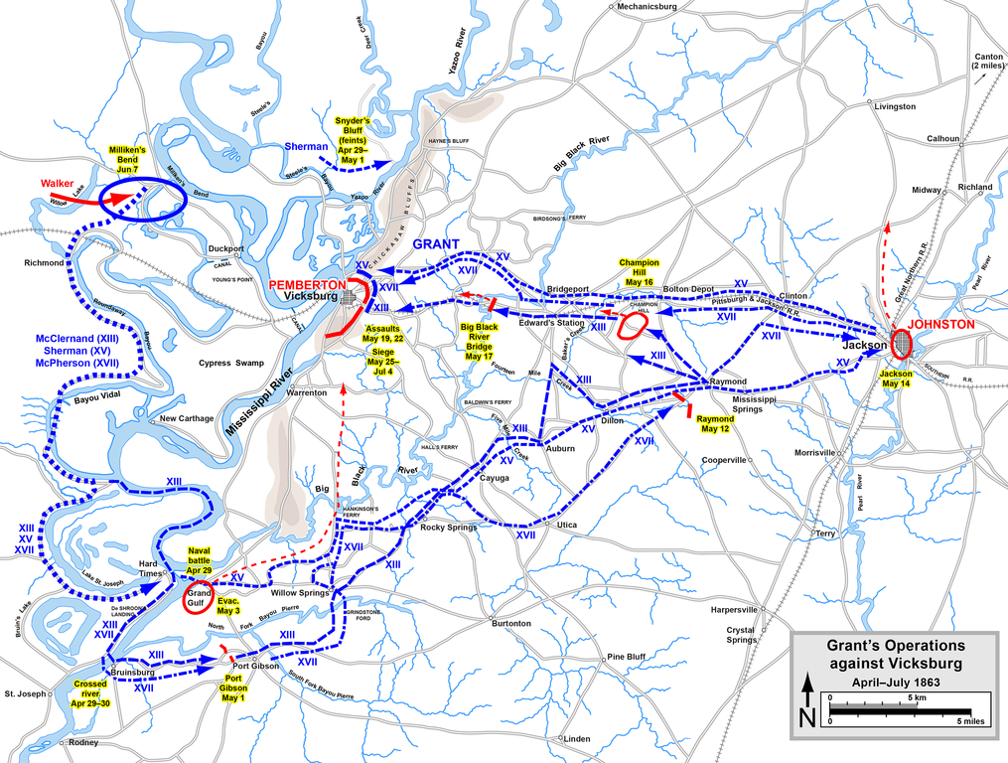
Battle of Vicksburg
Source: https://upload.wikimedia.org/wikipedia/commons/4/45/Battle_of_Vicksburg,_Kurz_and_Allison.png
Source: https://upload.wikimedia.org/wikipedia/commons/thumb/3/3c/VicksburgCampaignAprilJuly63.png/1015px-VicksburgCampaignAprilJuly63.png

Slide 15
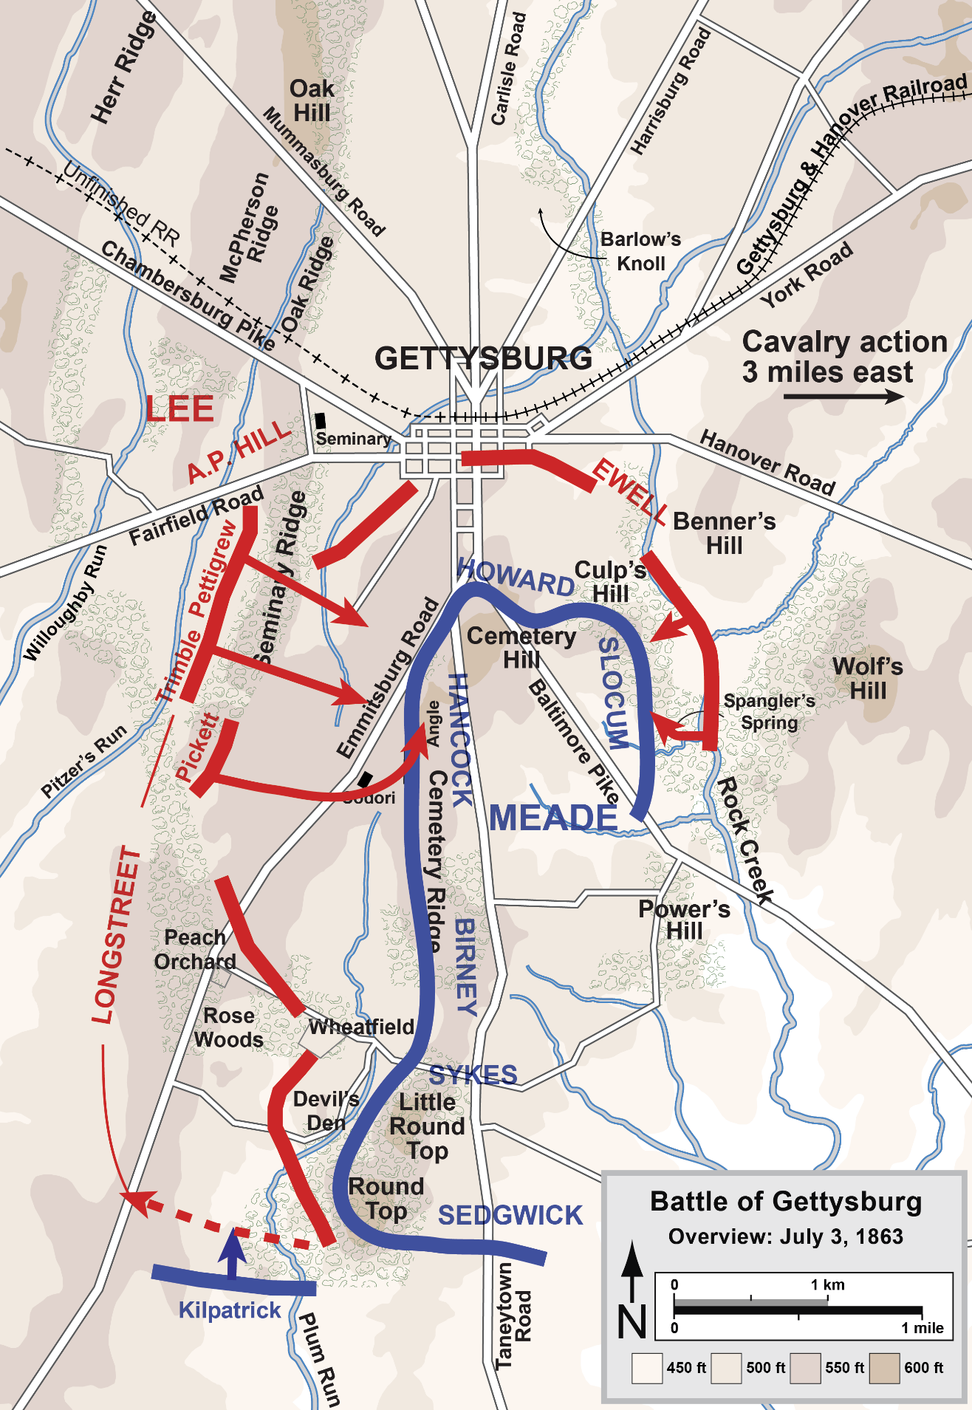
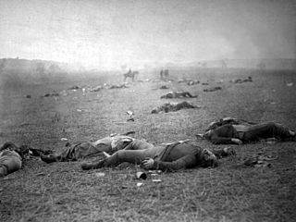
Battle of Gettysburg
Source: https://upload.wikimedia.org/wikipedia/commons/thumb/3/33/Battle_of_Gettysburg.jpg/320px-Battle_of_Gettysburg.jpg
Source: https://upload.wikimedia.org/wikipedia/commons/9/9e/Gettysburg_Battle_Map_Day3.png

Slide 16
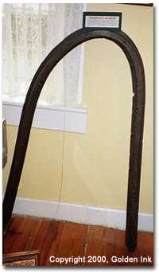
Sherman’s neckties
Sherman’s Necktie at Marietta History Museum
https://fr.wikipedia.org/wiki/William_Tecumseh_Sherman#/media/File:Destroying_CW_railroads.jpg

Slide 17
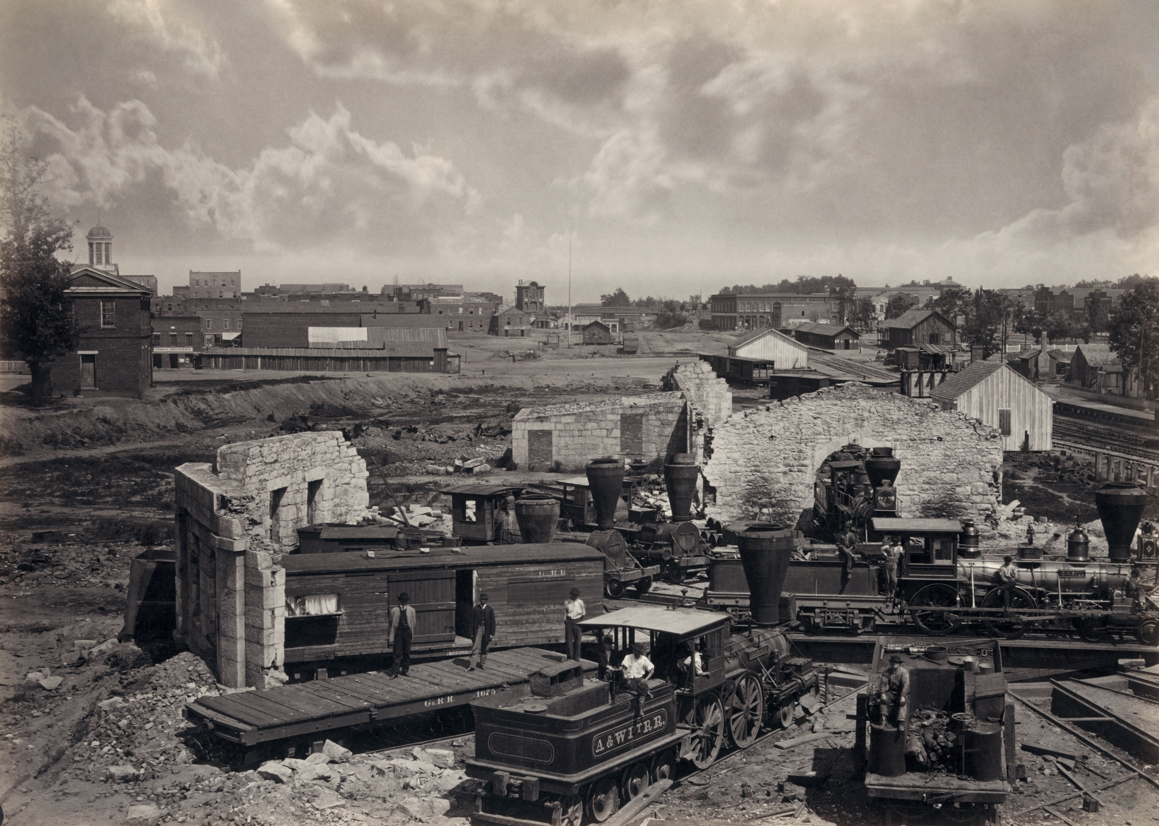
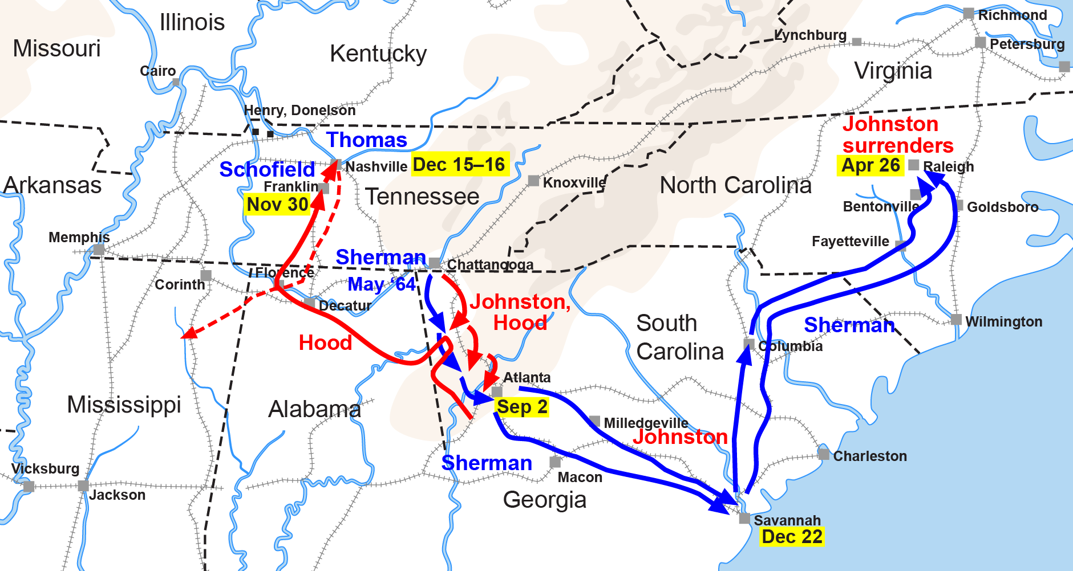
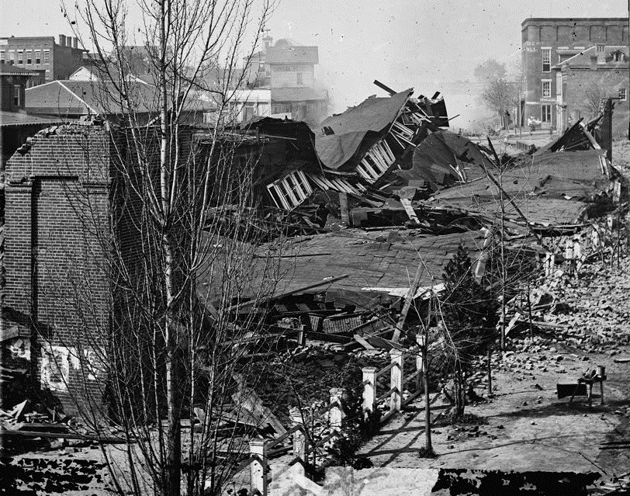
Battle of Atlanta
Source (map): https://upload.wikimedia.org/wikipedia/commons/a/aa/ACW_Chattanooga2Carolinas.png
Top Right: https://upload.wikimedia.org/wikipedia/commons/3/35/Atlanta_roundhouse_ruin3.jpg
Bottom Right: https://upload.wikimedia.org/wikipedia/commons/1/14/Atlanta_first_union_station_in_ruins_1864.jpg

Slide 18
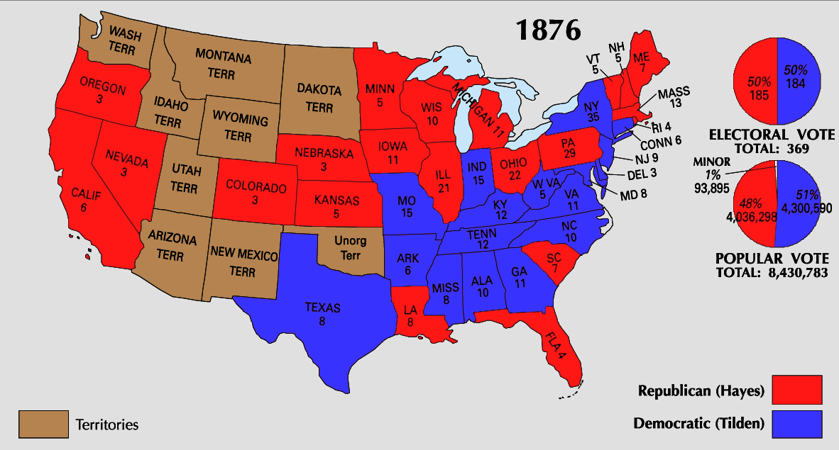
Election of 1876 Results
Source: https://upload.wikimedia.org/wikipedia/commons/3/30/1876_Electoral_Map.png

Slide 19
American Progress by John Gast 1872

Slide 20
Illustration by Udo J. Keppler from Puck magazine, 1895, depicting Uncle Sam dreaming of conquest.

