Slide 1
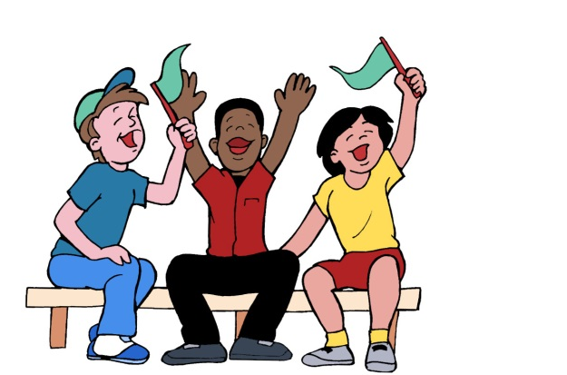
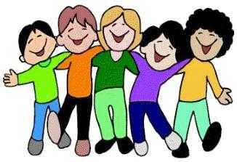
Fans and Friends
Remember that it takes a lot of courage to
share work with classmates.
Fans and Friends helps us choose our words
carefully and give criticism in a helpful way.
Never forget that everyone is important,
and everyone’s feelings count!
Help make our classroom a safe place
for sharing and for getting help.

Slide 2
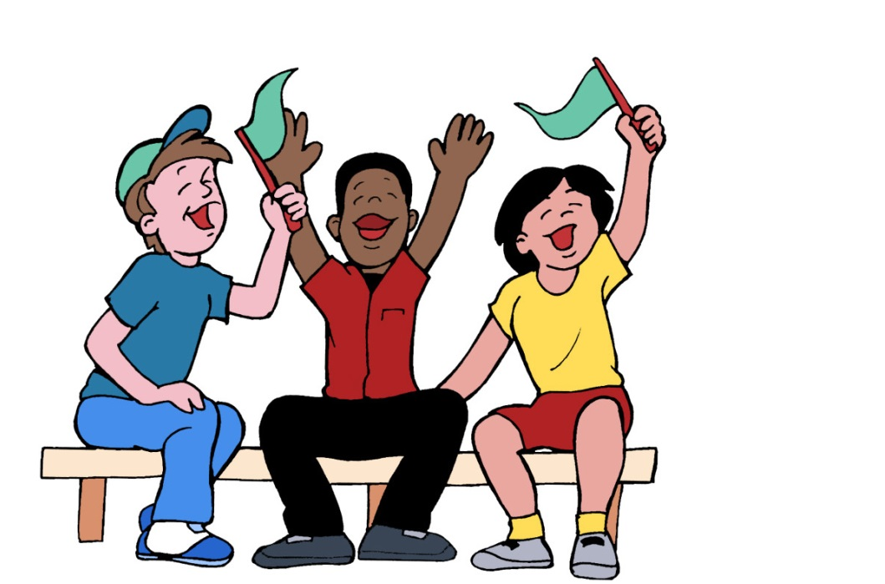
Fans
Friends
I am a fan of the way you _____________!
As a friend, I want to help you with ________.

