Slide 1
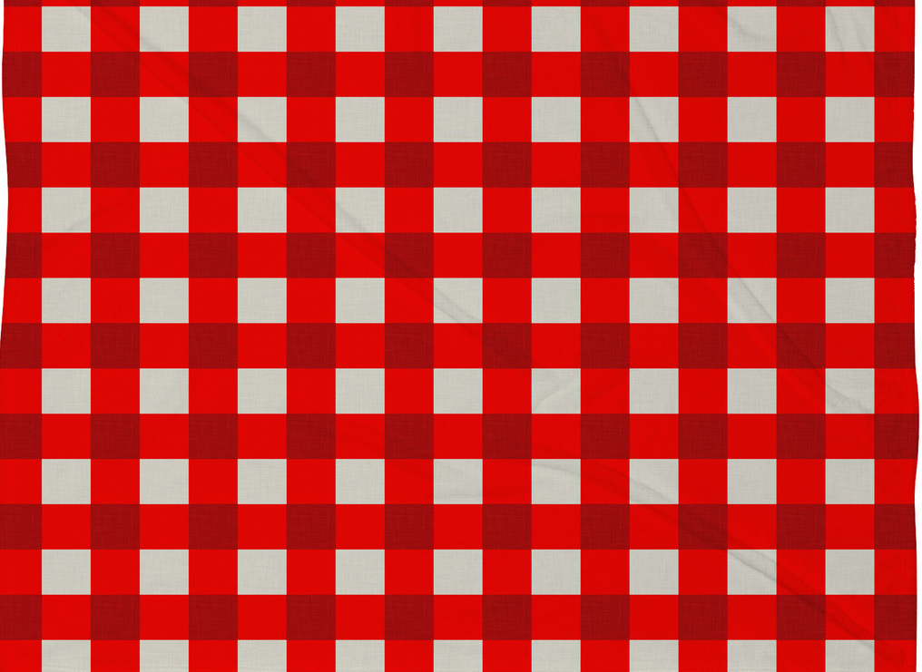
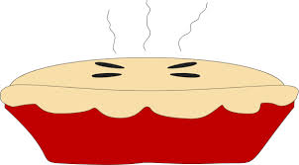
Lesson 3:
Lesson EQ:
What factors can cause a person’s first impression to change?
In a story, how can understanding perspective help us understand a character’s feelings?
What kinds of things affect a character’s point of view?
What does it mean for a character to grow?
Notes:
Essential Question and additional prompts for Lesson 1.

Slide 2
Additional Standards:
I can construct a response about what I am reading.
I can organize my response so that my ideas are grouped together in a way that makes sense to my reader.
I can introduce the book I am reading about with a strong topic sentence. (Presto Change-O)
I can make statements about the book that show my opinion.
I can support my opinion with text evidence. I can use linking words so that my writing has good flow.
I can provide closure to my reader and write a conclusion. (Hook it up!)
ELACC3W1: Write opinion pieces on topics or texts, supporting a point of view with reasons.
a. Introduce the topic or book they are writing about, state an opinion, and create an organizational structure that lists reasons.
b. Provide reasons that support the opinion.
c. Use linking words and phrases (e.g., because, therefore, since, for example) to connect opinion and reasons.
d. Provide a concluding statement or section.

Slide 3
Students:
By now, you know this story well!
It’s time to dig deeper!
Remember what you know about
CLOSE READING.
As we read the story again,
search for evidence and examples to
COMPARE and CONTRAST
the way the kid felt about Jeremy Ross at the beginning with how he felt towards him at the end of the story.

Slide 4
BEGINNING
END
CLOSE READ OF ENEMY PIE
How the kid felt at the beginning about Jeremy Ross:
(Text Evidence)
Did he like Jeremy Ross?
Did he want to feed him a really terrible Enemy Pie?
How the kid felt at the end about Jeremy Ross:
(Text Evidence)
Did he like Jeremy Ross?
Did he want to feed him a really terrible
Enemy Pie?
What happened to cause the kid to change his mind?
Notes:
Do a close reading of Enemy Pie. Analyze the main character’s feelings at the beginning of the book and then the end. Use this foldable to record notes (text evidence). This is a foldable. See photo on next slide.

Slide 5
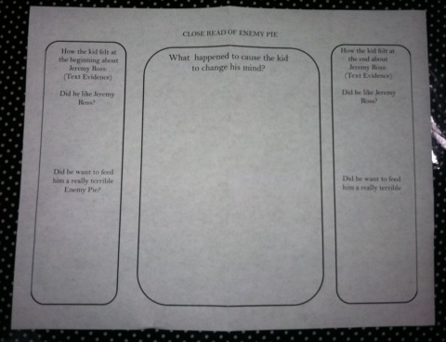
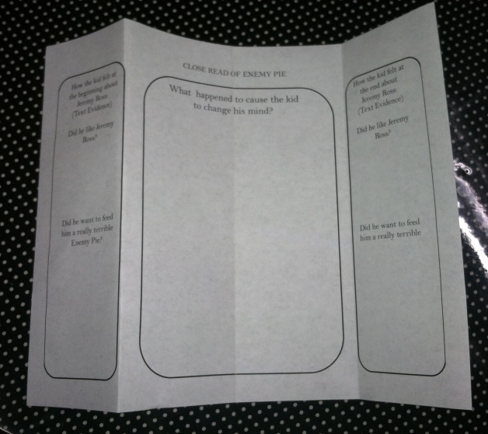
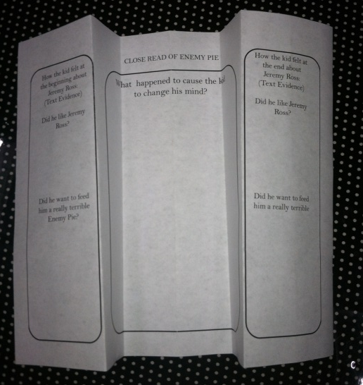
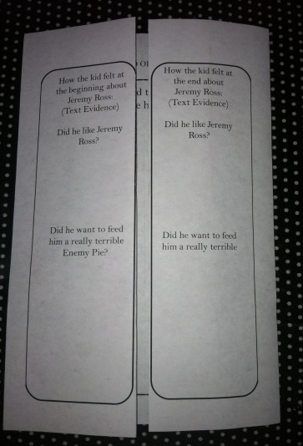
Foldable Instructions:
1. Lay organizer flat.
2. Fold in ½.
3. Fold in ½ again.
4. Open up and it is divided into ¼ sections.
5. Fold outside sections back
6. Bring the folds/seams to the center.
Add notes during close reading.
7. Open organizer and search text for reasons. Add notes to the center.

Slide 6
BEGINNING
KEY
CLOSE READ OF ENEMY PIE
END
How the kid felt at the beginning about Jeremy Ross:
(Text Evidence)
Did he like Jeremy Ross?
all good until Jeremy Ross
“I did not like Jeremy Ross”
JR laughed at the kid
struck him out
didn’t invite him to the trampoline party
invited his BF
ENEMY LIST
Did he want to feed him a really terrible Enemy Pie?
excited
“must be magic”
offered his dad gross ingredients
“great summer after all”
How the kid felt at the end about Jeremy Ross:
(Text Evidence)
Did he like Jeremy Ross?
strange; kinda having fun
boomerang
lunch
trampoline
tore down enemy list
sure is nice to have a friend
lost my best enemy
Did he want to feed him a really terrible
pie?
maybe forget about Enemy Pie
“I didn’t want Jeremy Ross to eat it.”
“Don’t eat it!”
bad/poisonous
What happened to cause the kid to change his mind?
Answers will vary. Examples:
The kid had fun playing with Jeremy Ross.
They threw water balloons at girls.
He taught the kid how to throw a boomerang, etc.
Notes:
Suggestion for completed organizer.

Slide 7
Writing Prompt
After reading Enemy Pie, explain how the story shows it is possible to turn an enemy into a friend. Compare the main character’s first impression of Jeremy Ross with his feelings towards Jeremy at the end of the story.
Notes:
Final Writing Prompt: The Big Kahuna! This is the big prompt. Hopefully by this point, students will feel very secure and familiar with the story and how to go about answering the prompt.

Slide 8
Note to Teachers:
Writing a constructed response involves many types of skills. I have provided some additional resources with this unit that have been very helpful for my students.
Please see the following for preparing students to successfully construct a response to this prompt.
Writing a Constructed Response
PATCH
Presto Change-O!
Close Reading Strategies
Notes:
Standards covered in this lesson.

Slide 9
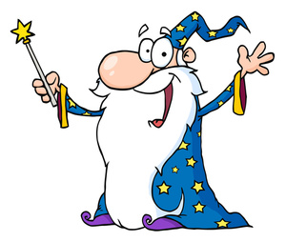
PRESTO CHANGE-O!
Name: _________________________________________
Prompt: (Underline Magic Words)
What do I have to understand to be able to answer this question?
What do I have to do to answer this question?
My Presto Change-O Topic Sentence:
Notes:
This graphic organizer is a part of a series of lessons called Presto Change-O and helps students to form topic sentences and prepare to answer a constructed response.

Slide 10
PRESTO CHANGE-O!
Name: _________________________________________
Prompt: (Underline Magic Words)
After reading Enemy Pie, explain how the story shows it is possible to turn an enemy into a friend. Describe how the main character’s first impression of his “best enemy” changed by the end of the story.
What do I have to understand to be able to answer this question?
The main character’s feelings at the beginning
The main character’s feelings at the end
The events that caused the change
What do I have to do to answer this question?
Describe how the main character felt at the beginning
Compare his feelings at the beginning to how the he felt at the end
Explain what happened to make him change his mind
My Presto Change-O Topic Sentence:
The book Enemy Pie shows us that it is possible to turn an enemy into a friend and you can’t always trust a first impression.
Notes:
Completed graphic organizer for this specific prompt.

Slide 11
SCORING RUBRIC | 4 ☺ Rockin’! | 3 Looking Pretty Good! | 2 Almost there. Keep trying. | 1 Oops! Need help with this.
Presto Change-O! (Change the prompt into a topic) | You used the prompt to form a strong topic sentence that makes sense. All important (magic) words are included. | You used the prompt to form a strong topic sentence that makes sense. Missing at least one important word or idea. | You used some of the prompt, but you are missing important words or ideas that cause your topic to be incomplete. | Your topic sentence does not use words from the prompt or you do not properly introduce your topic.
Answer the question (Organization) (No retelling of entire story! Stick to the question and stay on target.) | All your topic sentences are strong and relate to the exact question with no off-topic unnecessary information. Your supporting details are grouped together in a logical way. | Your writing has one or more of these problems: Incomplete answer Off-topic information Story retelling rather than answering the question Shallow answer; not enough detail | Your writing has several of these problems: Incomplete answer Off-topic information Story retelling rather than answering the question Shallow answer; not enough detail | You do not answer the question contained in the prompt.
Text Support Cite Evidence (Ideas/Content) (Must support your ideas!) | You provide many quality examples, quotes, and details that support your ideas and demonstrate a clear understanding of the text. | You provide some quality examples, quotes, and details that support your ideas and demonstrate a clear understanding of the text. | You provide at least one quality example, quote, or detail that support your ideas and demonstrate a clear understanding of the text. | You left out your supporting examples, quotes, and details.
Hook It Up! Conclusion/ Closure | Throughout your writing, you match ideas with support. At the end, you hook up all your ideas so that your reader clearly understands your opinion or position. You provide closure at the end. | Most of your ideas are matched with support. Your opinion is clearly stated for the most part. You added a conclusion. | Some of your ideas don’t match your support. There is not a good conclusion or any sense of closure at the end. | Your position or opinion is not clear. Your ideas do not relate to each other. There is no conclusion.
Conventions | Sentences-3 Cs: Capitalize/ Complete/Close NO LOWER CASE i as I Punctuate Quotations | Minor mistakes | Several mistakes | Many mistakes
Notes:
This rubric is based on our PATCH acronym for constructing responses. If you would like to use it, I have provided the initial lessons that will help explain the different components. However, you may feel free to substitute any rubric that you prefer instead of this one. If you don’t have a rubric that students understand and can use, I suggest searching online. There are many wonderful free resources available.

Slide 12
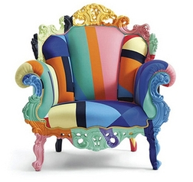
Author’s Chair:
Hurray!
Time to share your fabulous writing with your classmates!
Notes:
Time for students to share the finished products! For help with peer-editing and review, see Fans and Friends!

Slide 13
For more information on this and other learning units:
www.peachteach3.com
Michelle Davis, 3rd grade, Kingsland Elementary School
Kingsland, GA
mdavis@camden.k12.ga.us

