Slide 1


Lesson 2:
EQ: How do people form impressions about the
world around them?
What are our five senses?
Which sense is the most important?
How does sensory language help us visualize and connect?
How can I use sensory language in my writing?
Notes:
The focus of this lesson is identifying sensory language when we read and also adding sensory language into our writing.

Slide 2
Additional Standards:
I can identify expressions and how figurative language helps to create a certain image.
I can write a narrative story about something that really happened or something imaginary, like a trip to a bakery.
I can add details to my story that help describe events clearly, so that my reader can visualize and connect to it.
I can plan for my writing in a variety of ways. For example, I may use graphic organizers or word banks.
I can use technology to write, edit, and share my writing.
I can read something ahead of time and prepare for a class discussion. I can show that I understand the guidelines for the discussion.
ELACC3RL4: Determine the meaning of words and phrases as they are used in
a text, distinguishing literal from non-literal language.
ELACC3W3: Write narratives to develop real or imagined experiences or events using effective technique, descriptive details, and clear event sequences.
ELACC3W4: With guidance and support from adults, produce writing in which the development and organization are appropriate to task and purpose. (Grade-
specific expectations for writing types are defined in standards 1-3 above.)
ELACC3W5: With guidance and support from peers and adults, develop and strengthen writing as needed by planning, revising, and editing. (Editing for
conventions should demonstrate command of Language standards 1–3 up to and including grade 3.)
ELACC3W6: With guidance and support from adults, use technology to produce and publish writing (using keyboarding skills) as well as to interact and
collaborate with others.
ELACC3SL1: Engage effectively in a range of collaborative discussions (one-on-one, in groups, and teacher-led) with diverse partners on grade 3
topics and texts, building on others’ ideas and expressing their own clearly.
a. Come to discussions prepared, having read or studied required material; explicitly draw on that preparation and other information known about
the topic to explore ideas under discussion.

Slide 3
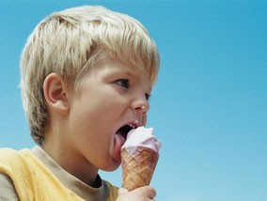

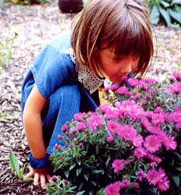
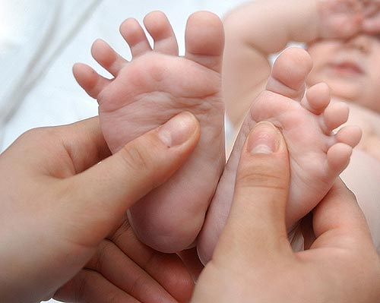

Notes:
These photos help students identify and relate to the five senses.

Slide 4






5
What are our 5 senses?
five
Senses
Notes:
Activate prior knowledge.

Slide 5
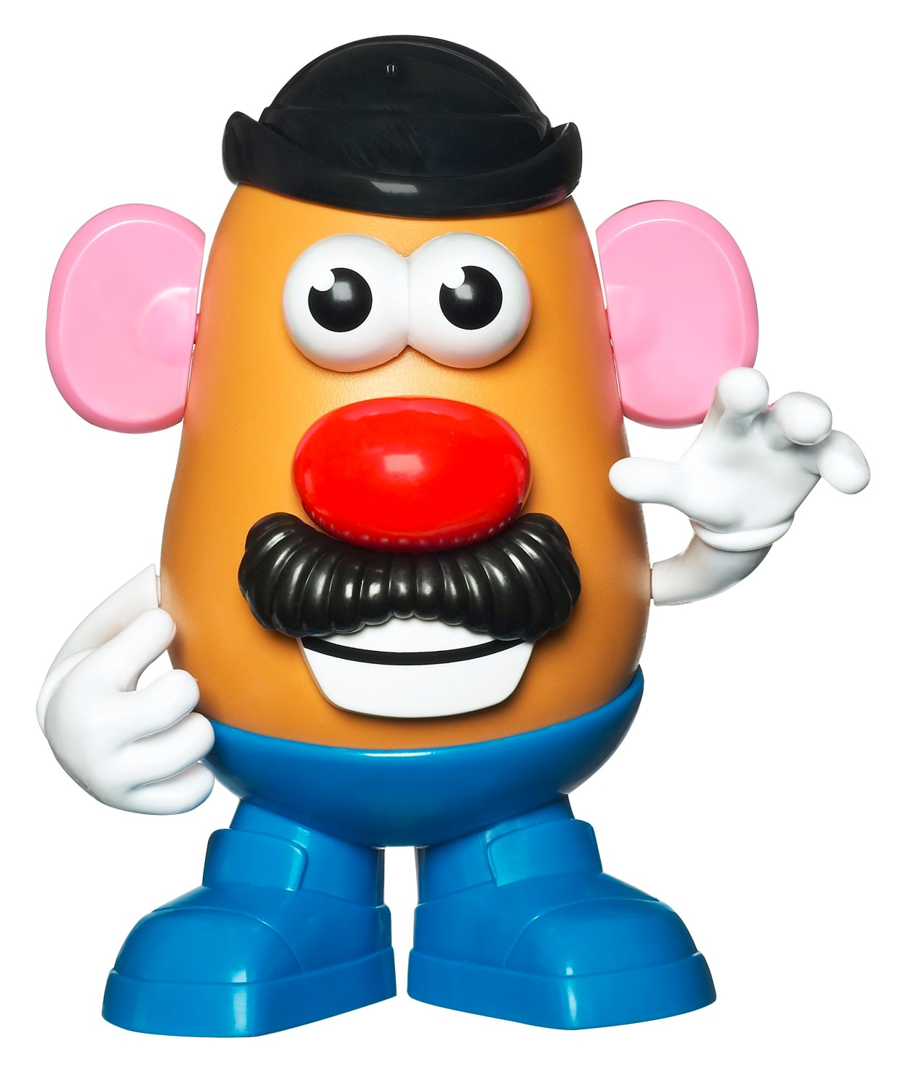
Mr. Potato Head can help us to remember our 5 senses!
Notes:
I use Mr. Potato Head to isolate a specific sense and focus on writing just about that one sense. For example, what might you see? How could you describe that? (Take off all the pieces except for the eyes.) You can pick one up at any toy store or maybe you even have one lying around your house! Very effective for sensory language lessons!

Slide 6
5
Our five senses allow us to take in information from our environment— from the world around us.
five
Senses

Slide 7
Pizza Hut Commercial
Notes:
Activating Strategy #2: Have students listen to the commercial with no picture, then watch the commercial with no sound. Then allow them to watch it with both sound and picture. Discuss: Which sense was most powerful in that experiment? Which version made you the most hungry? What does your reaction tell you about the power of your 5 senses? How is it important for writers to include sensory input?

Slide 8

Sensory details help
your reader relate
to your writing.
The better your
descriptions are, the
better your reader
will visualize, connect, & experience your story.

Slide 9


When you write,
Show. . .
Don’t tell!
Notes:
If you have already taught a lesson on “Show vs. Tell”, you can use this slide to remind students about that concept. If you have not, this would be a great time to introduce them to the idea. I recommend a more in-depth series of lessons on this topic at some point in the year.

Slide 10
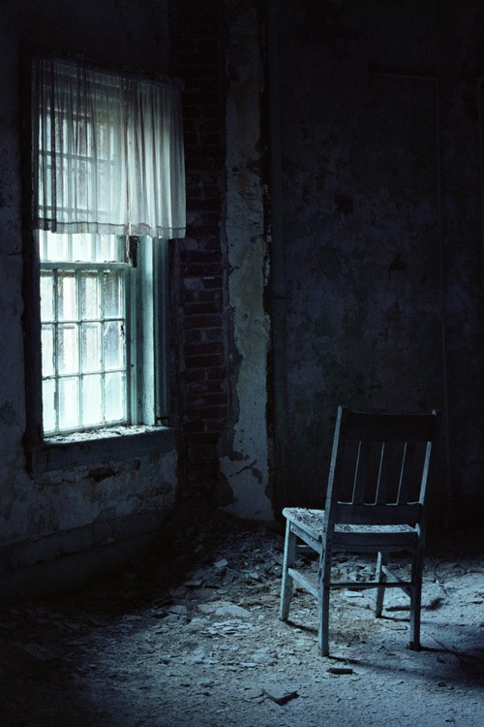
Notes:
Telling is boring! “The moon is shining” is not a very interesting sentence. “There is a glint of light on broken glass” is really interesting, and we can figure out that the moon is shining without hearing it directly stated.

Slide 11

sound
taste
Click on each box to see show vs. tell!
five
Senses
The peaceful lullaby soothed the cranky baby with the gentle sounds of the harp.
2. The mother played a lullaby.
I love the crunch of the salty pretzels and the smooth feel of the sweet chocolate coating.
1. Chocolate covered pretzels taste good.
smell
The foul stench of the rotting fish caused us to throw the cooler in the garbage.
3. The cooler really smelled bad.
sight
touch
The gorgeous sunset painted the sky with pinks, purples and blues.
As she dove in, the icy pool water cooled her hot, sunburned skin.
5. The sunset was pretty.
4. My skin felt hot, but the pool felt cool.
5
Notes:
Click on each box to show the difference between a telling sentence and a sentence that uses sensory language to show the reader. Stop and discuss each pair of examples.

Slide 12

Let’s visit a. . .
Notes:
A bakery is a perfect spot for a total sensory experience. So, inform students that you will be taking an imaginary field trip to the bakery.

Slide 13
Notes:
Use this graphic organizer to think about what you might see, hear, taste, touch, or smell on our imaginary field trip.

Slide 14
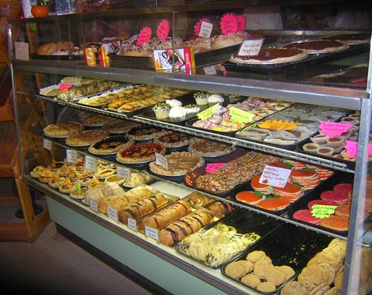
Notes:
As students look at the pictures, be sure that they note how items are arranged to be pleasing to the senses. The organization and the visual presentation are important.

Slide 15
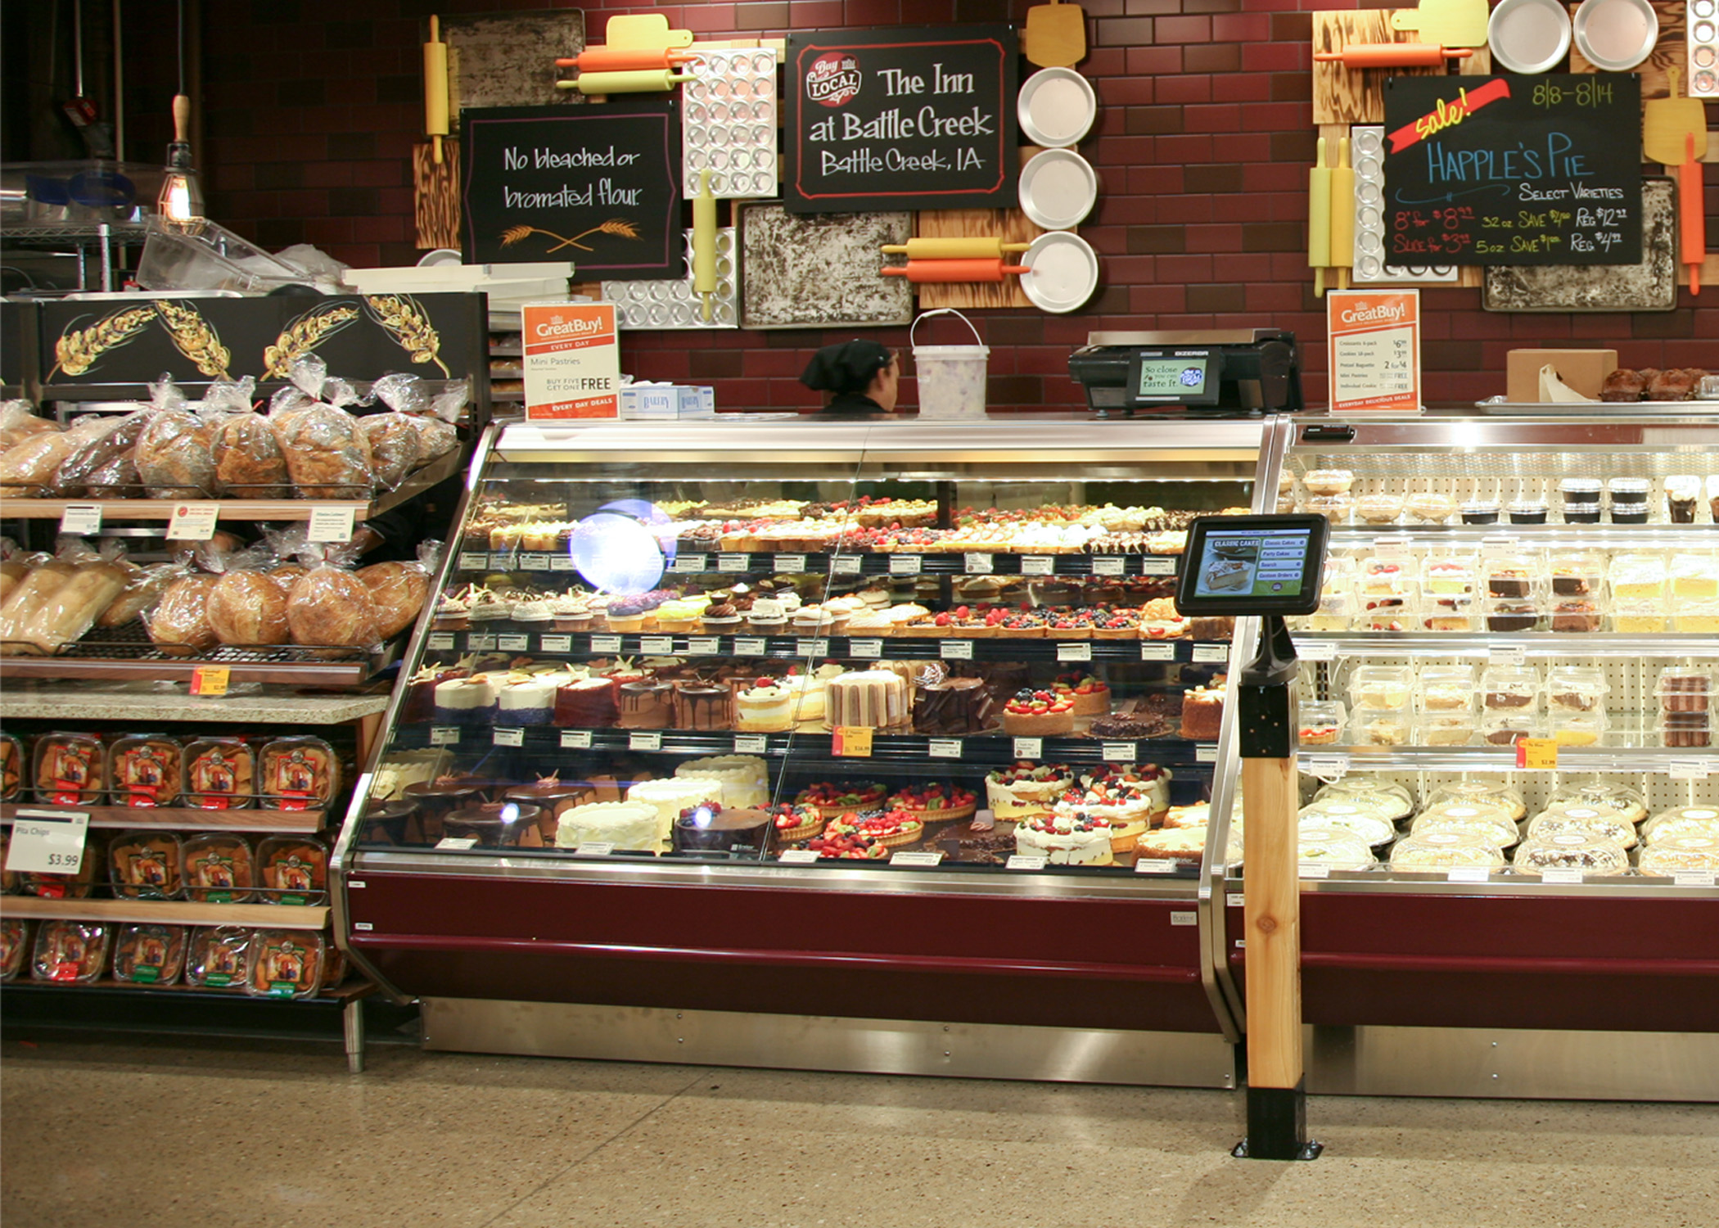

Slide 16
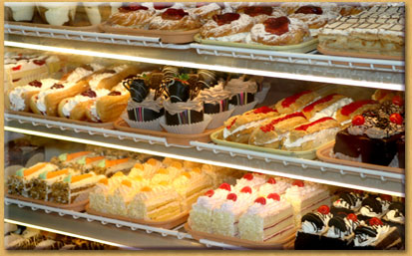

Slide 17
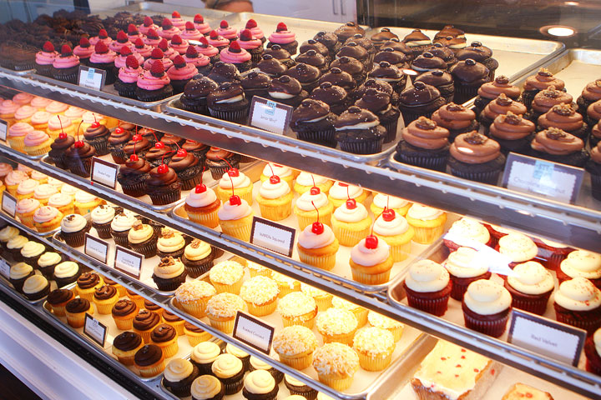

Slide 18
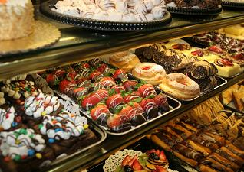

Slide 19


Slide 20


Describe your “trip” to the bakery. What kinds of things did you experience?
Here’s the catch. . .You cannot use the word bakery! (or bake, baked, baking, baker) Tell us what you saw, smelled, heard, touched, and tasted.
Let us figure out where you went!
Be sure to include lots of sensory details so that your reader can visualize and connect.
Writing with Sensory Language
Name: _________________
____________________________________________________________________________________________________________________________________________________________________________________________________________________________________________________________________________________________________________________________________________________________________________________________________________________________________________________________________________________________________________________________________________________________________________________________________________________________________________________________________________________________________________________________________
Notes:
Quick write: Students should describe what they saw, smelled, heard, touched, and tasted. They are not allowed to used the words bake, baker, baking, baked, or bakery! Remember SHOW, don’t TELL.

Slide 21


Summarize:
With your partner, read the following two writing samples closely. Read with a pencil! Think about the following questions and be prepared to discuss them as a group.
How does sensory language make writing more exciting?
How does sensory language help us to visualize and connect?
Notes:
Error Analysis: Students will look at two samples. One is very basic with little or no sensory language. It is overly simple, and it does not engage the reader at all. The second sample uses rich and vivid word choices to make it easy for the reader to visualize and connect. Read aloud the two questions/prompts on this slide and set the purpose for reading. Divide students into partners and provide them with the two samples. Have them do a close reading of each and be prepared for class discussion.

Slide 22

Sample 1
I went to the bakery. It smelled so good, and I loved it. the doughnuts was really good. The stawberries too.
I heard a buzzer. I want to go there every day.

Slide 23
Sample 2
She placed a thick slab of rich, dark, chocolate heaven on a plate. A tall glass of cold, creamy milk completed my order. I retreated to a corner booth where I could devour my delectable treat. I knew I would be coming back again and again to this amazing place.
As I entered, a pleasant jingle let the workers know a customer had arrived. I enjoyed the sight of all the employees hustling back and forth—stirring, mixing, and decorating. It was a happy, busy place. The chocolate-scented aroma of fresh-baked brownies made my mouth water and my tummy growl! “Would you like one of these?” a baker asked, wiping her flour-dusted hands on her apron.

Slide 24

Descriptive Writing Project
Create your own version of
Enemy Pie!
What ingredients would
you include in a pie made
for an enemy?
Notes:
Fun! Just like the main character of the book, students really enjoy imagining what could possibly go into a pie to get rid of an enemy!

Slide 25
Descriptive Writing Project
For this project you will complete:
A recipe
A descriptive paragraph
A decorated slice of your pie!
Notes:
Essential Question and additional prompts for Lesson 1.

Slide 26






Enemy Pie Recipe by ________________
Ingredients:
________________________________________-________________________________________________________________________________________________________________________________________________________________________________________________________________________________________________________________________________________
Instructions:
________________________________________________________________________-________________________________________________________________________________________________________________________________________________________________________________________________________________________________________________________________________________________________________________________________________________________________________________________________________________________________________________________________________________________________________________________
Notes:
This would be a great time to discuss recipes with students: their purpose, how to read them, and how to find crucial information. Also, the teacher should remind students about temporal words and phrases to signal steps in a process.

Slide 27
Enemy Pie Description by ____________
Write a description of your pie. Be sure to include lots of sensory details. How does it look, smell, taste, etc. Remember to SHOW, not tell. __________________________________________________________________________________________________________________________________________________________________________________________________________________________________________________________________________________________________________________________________________________________________________________________________________________________________________________________________________________________________________________________________________________________________________________________________________________________________________________________________________________________________________________________________________________________________________________________________________________________________________________________________________________________________________________________________________________________________________________________________________________________________________________________________________________________________________________________
Notes:
Ask students to reflect upon all they have learned in this lesson. Think about Mr. Potato Head and our 5 senses graphic organizer. Try to incorporate some interesting language into this writing. Remember the difference: Show vs. tell.

Slide 28
Enemy Pie Description by ____________
Write a description of your pie. Be sure to include lots of sensory details. How does it look, smell, taste, etc. Remember to SHOW, not tell.
My recipe for Enemy Pie _______________________________________ ___________________________ The ingredients are ______________ _____________________________________________________________ ________________________________________________________________________________________________________________________________ . My pie smells like ________________________________________ __________________________________________________________________________________________________________________________________________________________________________________________________________________________________________________. My recipe looks like ____________________________________________ ___________________________________________________________________________________________________________________________________________________________________________. I think my pie would taste like _______________________________________________ _____________________________________________________________
Notes:
Differentiation for struggling writers. The paragraph frame will help get reluctant writers started.

Slide 29
Really Cool, Descriptive Words
gross | prickly | disgusting | repulsive
rancid | repugnant | slimy | fetid
putrid | dangerous | explosive | bitter
rotten | spoiled | ruined | decaying
moldy | contaminated | putrefied | nasty
curdled | foul | soured | offensive
reeking | funky | ghastly | hideous
gruesome | vile | creepy | revolting
yucky | noxious | nauseating | rank
stinky | malodorous | fishy | pungent
Notes:
Vocabulary help.

Slide 30
Temporal or Sequence Words
first | second | third | fourth
last | finally | then | next
after | before | later | since
when | at the same time | afterwards | after that

Slide 31
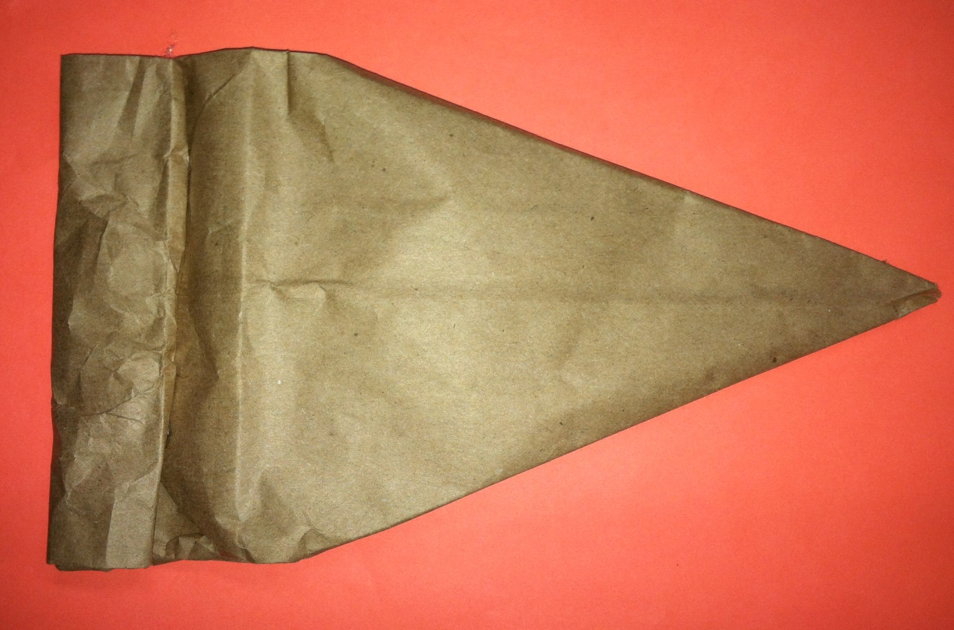
Decorate your pie!
Notes:
Each student is given a “pie” made from a brown lunch bag. They may choose to decorate this any way they like to match their recipe. When they are returned to school, I will attach them to a plate, add a napkin and fork, and post them with their writing in the hall for an awesome display!

Slide 32
Scoring Rubric
Decorated Pie
Pie is decorated and detailed. The decorated pie matches the descriptive paragraph and recipe. Clear evidence that you spent time and put forth your best effort.
10 points possible | _______/10
Descriptive Paragraph
Topic Sentence Sensory Details/Sensory Language Complete Sentences Capital Letters Punctuation
20 points possible | _______/20
Decorated Pie
Ingredients list is completed. Instructions are completed. Instructions use temporal words (at least 3) (first, next, later, etc.)
20 points possible | _______/20
TOTAL
Decorated Pie
Recipe
Paragraph
Multiply by 2:
Grade:
Notes:
Scoring/Grading Rubric

