Slide 1
Service Learning Project
How can we support homeless children in Savannah?

Slide 2

concerned
Notes:
Before discussing the vocabulary, invite two students to the board to be magical “Word Wizards.” Provide them with wizard props, such as a hat and wand. These students will help introduce each of the three vocabulary words.
Use this slide to introduce the word “concerned” to your students. Have students discuss the meaning of the word, and spell, drum, and clap the word. Students can also review phonics, identify letters, letter sounds, vowels, consonants, and learned vowel patterns.

Slide 3
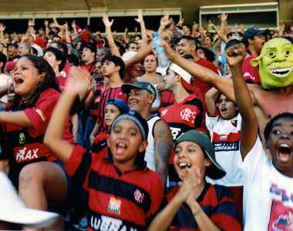
support
Notes:
Use this slide to introduce the word “support” to your students. Have students discuss the meaning of the word, and spell, drum, and clap the word. Students can also review phonics, identify letters, letter sounds, vowels, consonants, and learned vowel patterns.

Slide 4

compassion
Notes:
Use this slide to introduce the word “compassion” to your students. Have students discuss the meaning of the word, and spell, drum, and clap the word. Students can also review phonics, identify letters, letter sounds, vowels, consonants, and learned vowel patterns.

Slide 5
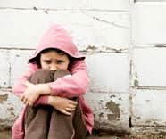
What does it mean to be homeless?
A person who is homeless does not have a place to live.
They have to live in a shelter, with other people, or on the street.
Notes:
Before you begin the discussion, set clear boundaries for the conversation. These boundaries will help students feel safe as you explore homelessness. Some boundaries might include: listen respectfully to others when they are speaking, what we talk about in the classroom stays in the classroom, etc. Emphasize that students who do not follow these guidelines will not be able to participate in the discussion. Once you have set these boundaries with students, begin the discussion.
As you will see in the video, I like to begin this discussion by activating student’s prior knowledge about needs and wants. Guide your students to identify shelter as a need, and use that answer as a springboard for the conversation.
Leave your personal opinions about homelessness out of the discussion, and provide students with factual information about the issue.

Slide 6
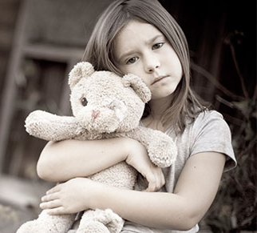
Can children be homeless?
Children can be homeless.
They are normal kids just like you.
They just do not have a place to stay.
Notes:
When you discuss homeless children, do not be surprised if students ask questions you did not anticipate based on things they have seen, heard, or experienced. Even if something alarms you, respond with a calm tone of voice and facial expression. Normalizing your reactions to students’ questions will not only help them safe and comfortable, but will also serve as a model for how your students should respond to each other.
As you will see in the video, it is also important to emphasize to your students that homeless children are normal children.

Slide 7
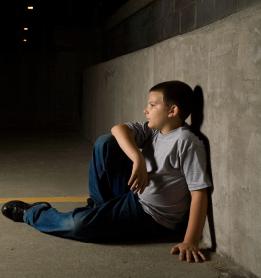
Are there homeless children in Savannah?
Last year 5,541 individuals experienced homelessness in Chatham County.
Of this population, 762 were children.
Notes:
Use the numbers on this slide to help children explore mathematics standards by counting the digits in each number and discussing the number and value of the tens and ones in 762.
Emphasize to students, again, that homeless children are normal children.

Slide 8
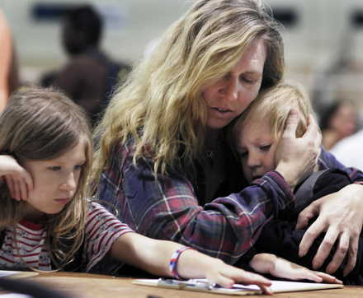
What causes homelessness?
Family problems
Loss of a job
Illness
Financial problems
Notes:
Again, as you talk about the causes of homelessness, provide factual information about the issue.
It is also important to stress to students that not every illness, family problem, etc. will lead to homelessness. Some students may become fearful during this part of the discussion that if they have a sick parent or their parents argue, they will soon become homeless. Emphasize that these factors do not ALWAYS cause homelessness. Keep an eye out for any students that may seem fearful or uncomfortable during this part of the discussion, and check in with them later, if needed.

Slide 9
How can we help homeless children in Savannah?
Notes:
At this part in PowerPoint, remind students that the goal of this project is to show support, concern, and compassion for homeless children in Savannah. Be sure to link the unit back to the vocabulary words and the standards they are learning.
This point of the PowerPoint is also a good time to have students brainstorm with a buddy about how they can support homeless children.

Slide 10
Created By:
Bynikini M. Frazier
1st Grade Teacher
Sarah Mills Hodge Elementary School
Savannah, GA

